Slide 1
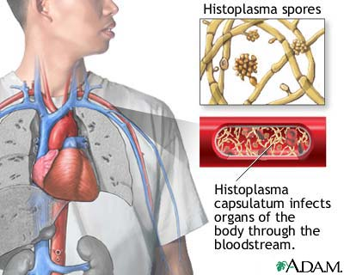
Histoplasmosis diseminada

