Slide 1
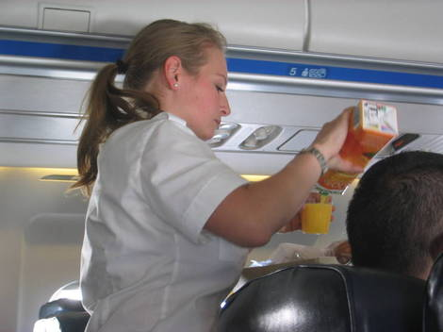
SERVING SNACK
SERVING JUICE
SERVING BEVERAGES
SERVING MEALS

