Slide 1
Connor Becker - What’s Up?
Helping get concept maps up and onto the public servers
Use-case specification for “Generate Student Preferences”

Slide 2
Student Preferences?
Hard Data
Soft Data
Enrollment information
Dates and Grades for Taken Classes
Class standing
Student Availability
Specified as an iCalendar file
Particular Course Choices
What science classes to take
What electives, etc.
Min/Max Credit Hours

Slide 3
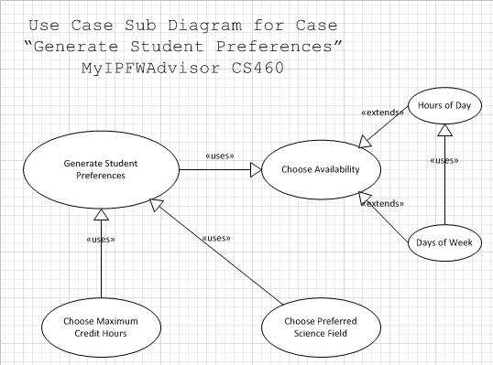
UML Use-Case Diagram

