Slide 1




UNIVERSIDAD TECNOLÓGICA OTEIMA
ESPECIALIZACIÓN Y MAESTRÍA EN DOCENCIA SUPERIOR
TECNOLOGÍA DE LA INFORMACIÓN Y COMUNICACIÓN A NIVEL SUPERIOR
PROFESOR: MSc. SANTIAGO QUINTERO

Slide 2
Liberal Arts Department
School of English
Teaching Methodology for the Acquisition of a New Language
Professor:
Eduardo Henry Rudas

Slide 3


Pantallazo Motivacional

Slide 4
Introduction
To improve the quality of education, many teachers are introducing new elements of learner-centeredness into the curriculum development process according to a particular group of students and their own philosophy of teaching. That is why, we will see concepts as:
Techniques Learners factors
Learning outcomes Learning Processes

Slide 5

Central Concepts
Outcomes based
Current, relevant
Employability
Variety of teaching techniques
Student-centred
Interactive Strategies
Verbal and Symbolic .
Collaborative, team works.
Knowledge skills and attitudes should be assessable, transferable and relevant to their lives as workers and citizens.
Teaching Methodology
Strategy of Teaching Process
and Who is the learner?
Knowledge and Skill
Profile
Learning Strategies

Slide 6

Benefits of Designing New Techniques
Informed learners - what they can expect to achieve from a program – so they can organize time and efforts.
Helps to determine the extent to which learning has been accomplished.
Systematic planning
Improve learning
Communicative purposes
Learner-centered activities
Emphasis on intuition
Skills of analysis and reason
Flexibility
Needs
Interests

Slide 7
WHO IS THE LEARNER ?
attitudes
Community
Family
The Student
Maturity
Culture
Gender and
History
Support
Socio-economics

Slide 8
What are the learning outcomes?
They are a statement of what the student should know and be able to do when they complete a program or course:
knowledge, attitudes and skills.
Learning outcomes are related to the needs analysis of the student (for employment) rather than the needs of the instructor

Slide 9
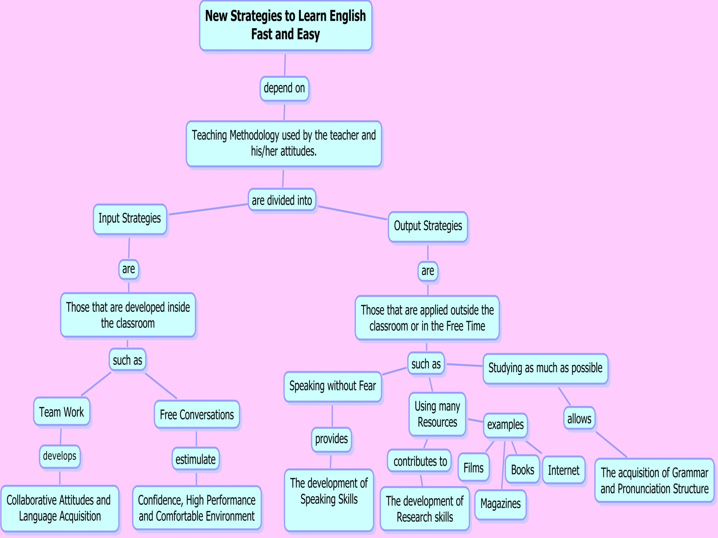

Slide 10

How do you know if your students are learning?
Learning Indicators
(Measures of success)
To determine whether students are meeting the outcome
Learning/Teaching Strategies
To provide students with knowledge and abilities to meet the outcome

Slide 11
Main key
Learning strategies must be done to serve the needs of the learners and to aid them in developing their own unique, individual pathways to success.
Collaboration
Interaction
Integration

Slide 12
Learners Factors
communicative goals in which their real-life needs for English will be met.
Proficiency level
Education, interests
Specific language needs
Learning process in which students are able to apply their skills participating actively.

Slide 13
Learning Processes
Knowledge
Evaluation
Assessment
Comprehension
Learning Cycle:
Knowledge
Analysis
Application
Synthesis
Tacit Knowledge
At the end, makes an essay about this learning cycle.

Slide 14
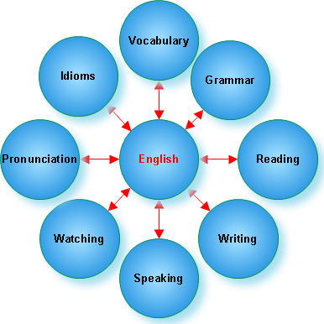
English video

Slide 15

Thanks

