Slide 1
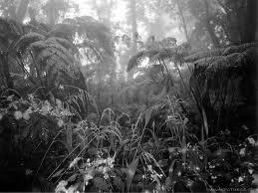
Life in a Rain Forest
Author: Anne Welsbacher
Shiyuan Huang

Slide 2
Summary
Life in a Rain Forest by Anne Welsbacher was written to inform readers about the Hawaiian rain forest. First, the book included information about ecosystems. Then, it stated information about the Hawaiian rain forest and evolution. Next, it gave information about the various zones in the Hawaiian rain forest. Finally, it revealed how humans interact with the Hawaiian rain forest.

Slide 3
Layers of the Rain Forest
The canopy, understory, and groundcover make up the Hawaiian rain forest
Canopy is the tops of trees growing together; filled with birds
Understory is shaded by the canopy; plants, birds, and arthropods live there
Groundcover is made up of the soil and the things on it; snails, plants, and arthropods live there

Slide 4
Evolution
The few species that got to the Hawaiian rain forest evolved into many new species
Gentle climate made for fast evolution
Defense mechanisms disappeared because of the lack of predators
Organisms coevolved, adapting based on the changes in others
Question: Will new organisms evolve from the organisms that are still left?

Slide 5
Humans and the Rain Forest
Humans and the animals brought by humans changed the rain forest ecosystems
Forests were burned down by humans
New animals killed the native animals
New animals destroyed habitats

