Slide 1
Methicillin Resistant Staphylococcus Aureus Alert Implementation
Miley Cyrus
Peter Tosh
Ban Ki-Moon

Slide 2
Formulation & Scope of Informatics Problem
Electronic health records (EHR) in health care facilities nationwide has been an attempt to improve the quality of care and control health care costs (Barey, 2009)
Decision support is an aspect of the EHR that provides reminders and alerts to improve the diagnosis and care of a patient (Barey, 2009)
Community aquired Methicillin-resistant Staphylococcus aureus (CA-MRSA) has seen a dramatic increase in the outpatient setting. It is predicted that it will eventually surpass Hospital acquired MRSA.
Decision support alerts specific to MRSA in the outpatient setting allows enhanced monitoring and treatment interventions.
  Infection control department able to accurately track infection rates and trends
  Enables development of enhanced patient education and treatment interventions as needed

Slide 3
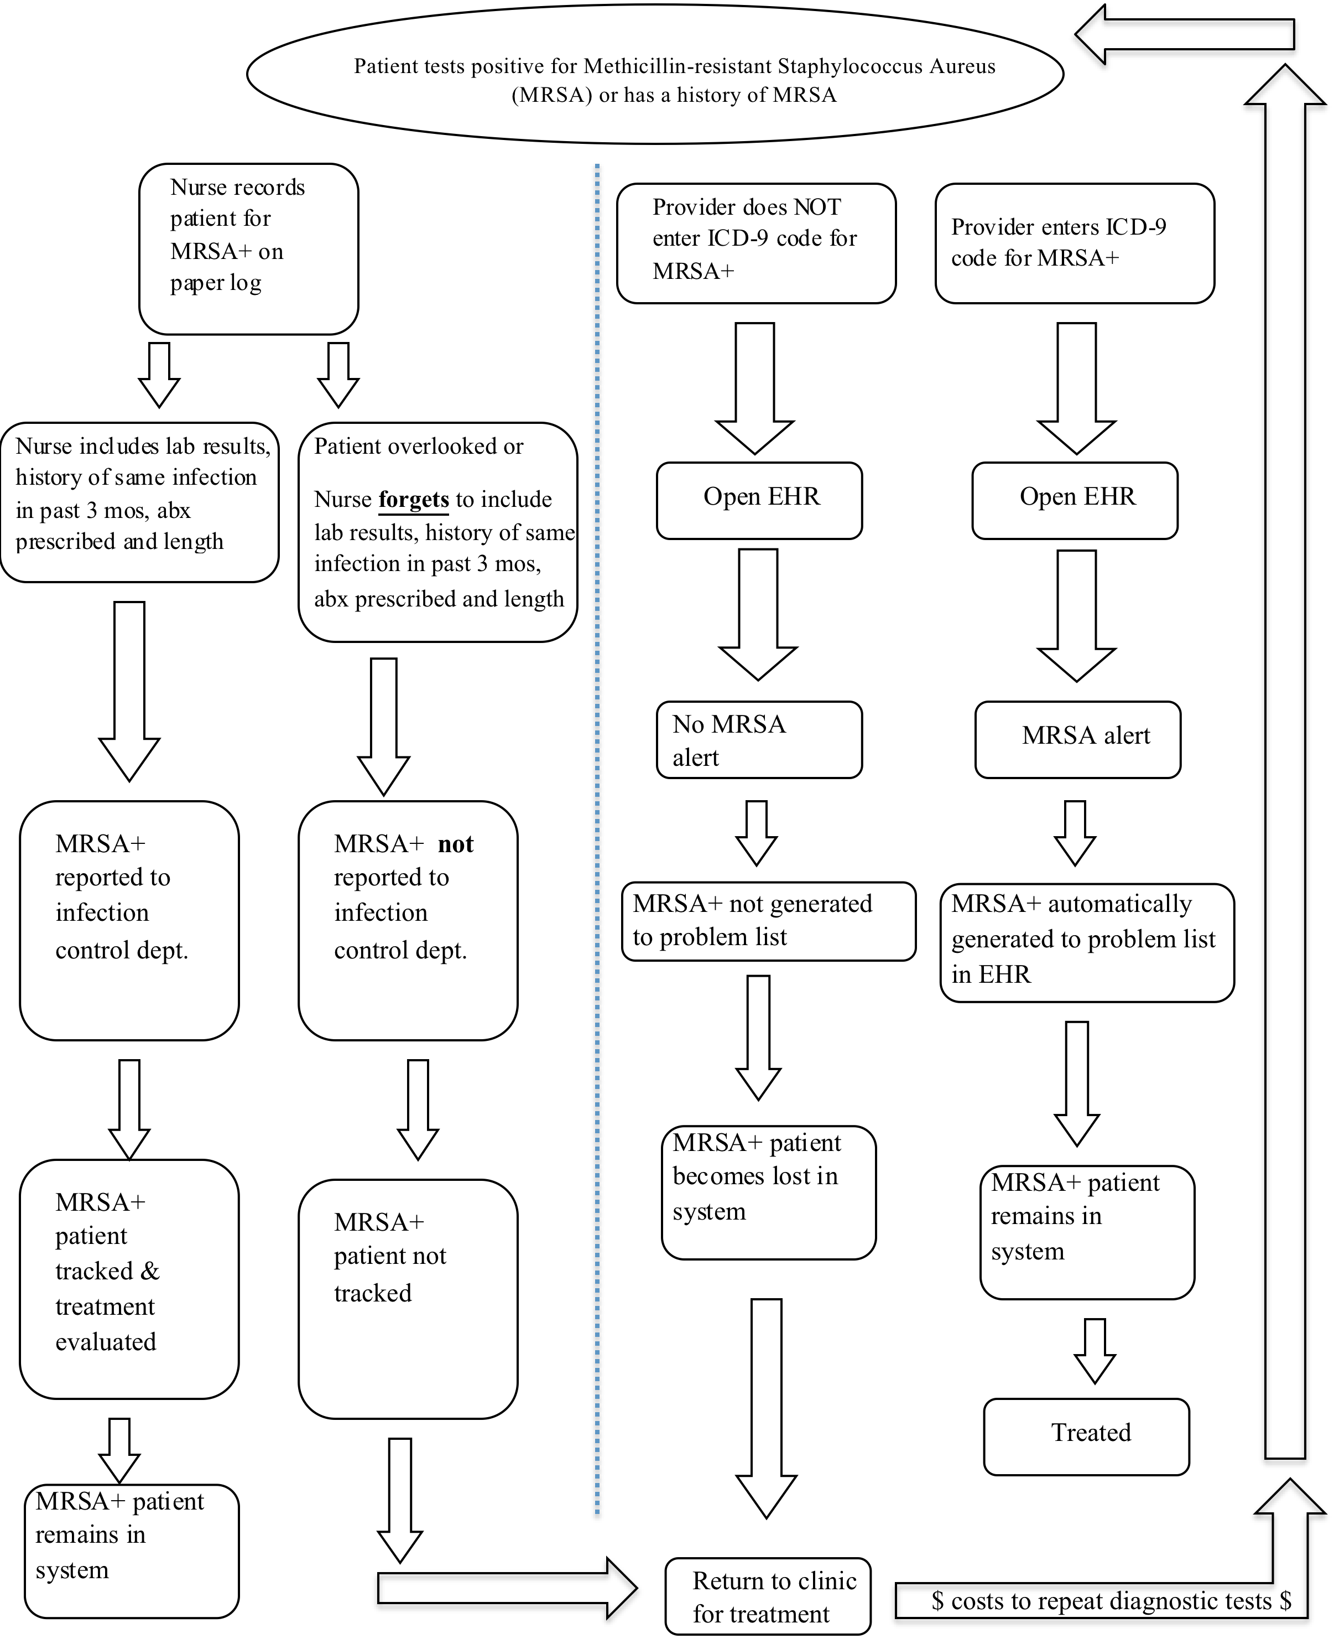
Current Process Flow Sheet

Slide 4
Significance of Problem
Accurate surveillance of CA-MRSA within the outpatient setting is an important factor to ensure patients are being properly treated and educated regarding the bacteria (Mark, 2007).
Currently, no alerts generated for MRSA positive patients in the EHR
Input of ICD-9-CM diagnosis code for MRSA very inconsistent
  No diagnosis code entered=No generation of MRSA in Problem list
Current process of tracking dependent upon nurses recording MRSA patient’s data on paper record
  Not all patient recorded do to human error
  Real-time updates on MRSA infection rates not available
  Infection control department unable to mine data and run accurate analysis of infection rates/trends if MRSA diagnosis code not entered for patient
Increased community surveillance and bolstering infection control measures is needed to moderate the effect of CA-MRSA in outpatient settings (Mark, 2007)

Slide 5
Environment Risk Analysis
Our clinic – Combination of wound clinic and IV infusion clinic
  Wound clinic – 1 large room, 2 treatment tables, 1 sink, 2 supply cabinets
  One medication room shared by both clinic w/ an Omnicell
MRSA contamination
Paper documentation – HIPPA, problems with data availability and real time updates.

Slide 6
System Analysis
Model for Defining Information System Requirements (MDISR) – 5 elements
  Users Element
    Inputs: Users Element, Functions, Information Handling
    Output: Information Functions
  Information Processing Element
    Inputs: Information Functions, Practice Responsibilities
    Output: Information Processing Requirements
  Information Systems Element
    Inputs: Information Processing Requirements, Computer System Characteristics, Existing Computer Systems
    Output: System Output
  Information Element
    Inputs: System Output, Available Data
    Output: Nurse Data Requirement
  System Goals
    Inputs: Data Requirement, System Output, System Goals
    Output: System Benefits

Slide 7
Feasibility of Solution
Proposed solution:
    Create an add-on alert feature to the wound clinic’s existing Resource Patient Management System (RPMS) software
RPMS electronic health record (EHR) is used in 190+ Indian Health Service facilities nationwide (DHHS, 2011)
An add-on involves
  Cost effective solution to tracking MRSA+ patients
      Additional costs only maintenance related
  Minimal additional training
  Improved safety of patients and providers
  Empowers clinician decision-making
      Will not disrupt current workflow
Julius system (Chen et al., 2007)
  A template based system implemented in Swedish health facilities
  An add-on to existing EHR online networks was successful
  Eliminated duplicate data recording
Notes:
-Implementation costs would have been covered at the initial establishment of the EHR in prior years.
-(i.e. After implementing and utilizing RPMS EHR, the Community Health Network of West Virginia (2008) noticed dramatically lower costs compared to commercial vendors--RPMS maintenance costs averaged $43,200 compared to commercial maintenance costs of $133, 632 (Community Health Network of West Virginia, 2008).
-Brief additional training, may be done online. Pamphlets, web-based sessions available.

Slide 8
Hardware & Software
  RPMS EHR aims:
  Adaptive scalability in its hardware
  Limitless flexibility in its 35+ software applications
  Unlimited network connectivity
Hardware:
  Easily accessible computer stations
  Network lines and server
  Fax machine, printers, scanners, telephones
Software:
  Continually improving
    “Patches” and updates readily available and easily downloaded online
    Automatically downloaded updates to users’ computers once application is
(DHHS, 2011)
Notes:
RPMS EHR Software Requirements*
File 200 must be current
Fileman 22/Kernel 8 with latest patches
Caché operating system
Pharmacy v4.5 Suite
Patient Information Management System (PIMS) version 5.3 (this includes Admit/Transfer/Discharge (ADT), Scheduling, and Sensitive Patient Tracking)
Three additional VHA applications that are required to run in the background:
Lexicon v2.0
Visit Tracking v2.0
VA Health Summary v2.7
RPMS and VHA Software Compatibility*
Text Integration Utility (TIU) v1.0 (a template-based notes authoring application)
Laboratory v5.2
Women's Health v2.0
Immunization v8.0
Radiology v5.0
Pharmacy Inpatient v5.0
Pharmacy Outpatient v7.0
Order Entry/Results Reporting (OE/RR) v3.0
VistA Imaging version 3.0 (a separate project is underway to make VistA Imaging available to I/T/U facilities)

Slide 9
Implementation Plan
Follow five phases: initiation, planning, execution, monitoring and closing (Reynolds, 2010)
Initiation phase- December 1, 2011- January 1, 2012
  Discussion with nursing staff, physicians, patient care technicians, infection control staff, and the laboratory manager for ideas and needs
  Staff opinions + non-participatory methods of evaluation (Coiera, 2003)
Planning phase- January 2, 2012- February 2, 2012
  Project committee will include: technology (IT) programmers, education team, nurse champion, physician champion, project facilitator, two nurse volunteers and two physician volunteers
  Develop timeline and tasks
    Include: Evaluation criteria and education plan

Slide 10
Implementation Plan continued…
Execution phase- February 3, 2012- April 2013
  Implement proposal
    IT to develop code & test alert
    Market add-on feature
    Test alert system- load test
    Change code if necessary
    Interactive education for staff
    System evaluations
Monitoring phase-Simultaneous with execution phase
  Evaluations at 1 week after, 3, 6, and 12 months.
Closing phase- To be completed by April 2013

Slide 11
Education
Educational team:
  clinical educators, IT programmers, nurse and physician champions, and the program facilitator
Initial overview:
  assist staff in accepting the implementation of a MRSA alert feature
  added benefit to improving patient care, clinical decision-making, and communication
Training sessions:
  clinical case scenarios
  opportunity to ask questions
  address potential problems
  Instructional pamphlets
  proficiency checklist and provide feedback
On-line learning management system
  additional case scenarios
  Multiple choice questions with a minimal score of 85%
Notes:
The educational plan will utilize a variety of techniques and tools to promote optimal user education and literacy. According to Johnson, Johnson, & Zhang (2005), “This information is needed because different types of users require different types of interfaces”.
Educational team:
The educational team will guide trainees through a test mode of the EHR system.
Initial overview:
Each session will begin with an overview of the importance of accurate documentation, followed by a review of the facilities mission and vision statements.
Rather than additional workload
Training Sessions:
By offering training sessions with realistic working situations the users have the ability to ask questions and address potential problems that may arise while using the new system (Mercer & Felt, 2010).
A brief question and answer session will be offered at the end of each session where EHR developers will be available for further elaboration.
Convenient instructional pamphlets will be provided to all attendees to serve as a quick reference guide
sign a form verifying their active participation in the class and acknowledge the requirement to adhere to the new process for MRSA reporting
provide feedback about the course via an evaluation form (Mercer & Felt, 2010). The comments will be shared with the educational team, and improvement made as needed.
On-line learning management system:
If a user fails to achieve a score of at least 85%, they may review the educational material and repeat the modules. These online modules will be an annual requirement for all employees to complete.

Slide 12
Evaluation Plan
Goal: bring ease and accuracy to tracking MRSA infections and prevent unnecessary spread within the wound clinic and among the community. The system would also provide the ability to acknowledge recurring trends and deliver educational interventions appropriately
Continuous evaluation (Coiera, 2003)
Satisfaction Questionnaires
Cost-benefit analysis- $60,000 profit per provider per year (based on studies from Community Health Network of West Virginia (2008), Wang, et. al. (2003) and Chaix, Durand-Zaleski, Alberti, & Brun-Buisson (1999).
  Profit will increase when productivity loss is decreased over time (Wang et. al, 2003)

Slide 13
User Satisfaction Questionnaire

Slide 14
Cost-benefit Analysis

Slide 15
Potential Issues
Security and privacy breaches:
  individual user login
  Individual access codes and passwords
Social and cultural discrimination:
  Four principles of bioethics by Beauchamp and Childress
    Autonomy
    Beneficence
    Nonmaleficence
    Justice
Economic costs:
  Federal qualified health center
  enhanced Medicaid & Medicare reimbursement
Notes:
Security & Privacy Issues:
Security and privacy are potentially the most significant problem with electronic records because there is always a possibility that private information could end up in the wrong hands (Torrey, 2009).
In addition, each employee is required to undergo annual HIPPA training to ensure patient privacy and confidentiality is at the forefront of all operations.
Social & Cultural:
According to Winkelstein (n.d., para 1) “advice produced by decision support systems must be understood and acted upon in the context of the overall goals and values of health care.” In addition, “data mining may impact confidentiality or lead to discrimination by identifying subgroups” (Winkelstein, n.d., para. 1).
Economic Costs:
potential issue because EHR systems are costly to implement and maintain
According to the Rural Assistance Center (2011), facilities that serve and underserved population, provide comprehensive services, offer a sliding fee scale, have a governing board, and have an ongoing quality assurance program meet the requirements for a Federally qualified health center, which allows enhanced Medicaid and Medicare reimbursement.

Slide 16
Proposed Process Flow Sheet

Slide 17
References
Acker, B., Bronnert, J., Brown, T., Clark, J. S., Dunagan, B., Elmer, T., Tegen, A. L. (2011). Problem list guidance in the EHR. Journal of AHIMA / American Health Information Management Association, 82(9), 52-58.
Ash, J.S., Berg, M., & Coiera, E. (2004). Some unintended consequences of information technology in health care: The nature of patient care information system-related errors. Journal of the American Medical Informatics Association, 11(2), 104-112.
Barey, E. (2009). The electronic health record and clinical informatics. In D. McGonigle & K. Mastrian (Eds.), Nursing informatics and the foundation of knowledge (219-237). Sudbury, MA: Jones and Bartlett.
Blair, G.M. (n.d.) Planning project. Retrieved from http://www.ee.ed.ac.uk/~gerard/Management/art8.html
Boston-Fleischhaur, C. (2008). Enhancing Healthcare Process Design With
Human Factors Engineering and Reliability Science, Part 2: Applying the Knowledge to Clinical Documentation Systems. The Journal of Nursing Administration 38(2), pp. 84-89.
Centers for Disease Control and Prevention [CDC], 2011. International classification of disease, ninth revision, clinical modification (ICD-9-CM). Retrieved from http://www.cdc.gov/nchs/icd/icd9cm.htm
Chaix, C., Durand-Zaleski, I., Alberti, C., & Brun-Buisson, C. (1999). Control of endemic methicillin-resistant Staphylococcus aureus: A cost-benefit analysis in an intensive care unit. The Journal of the American Medical Association, 282(18), 1745-51. doi: 10.1001/jama.282.18.1745

Slide 18
Chen, R., Engberg, G., & O’Klein, G. (2007). Julius-a template based supplementary electronic health record system. BMC Medical Informatics and Decision Making, 7(10), 1-11.
Coiera, E. (2003). Guide to health informatics. London, England: Hodder EducationCommunity
Health Network of West Virginia. (2008). RPMS-EHR. Retrieved from,http://www.chnwv.org/Solutions/RPMSEHR/Investment/tabid/117/Default.aspx
Gassert, A. (1996). A model for defining information requirements. In M.E. Mills, C.A. Romano, & B.R. Heller (Eds.), Information Management in Nursing and Healthcare (pp. 7-15). Springhouse, PA: Springhouse Corporation.
Gassert, A. (1990). Structured analysis: methodology for developing a model for defining nursing information system requirements. Advance Nursing Science, 13(2), 53-62.
Holden, R.J. (2011). What stands in the way of technology-mediated patient safety improvements? A study of facilitators and barriers to physicians’ use of electronic health records. Journal of Patient Safety, 4(4), 193-203.
Johnson, C. M., Johnson, T. R., Zhang, J. (2005). A user-centered framework for redesigning health care interfaces. Journal of Biomedical Informatics 38, pp. 75-87.
NeVille-Swensen, M., & Clayton, M. (2011). Outpatient management of community-associated methicillin-resistant staphylococcus aureus skin and soft tissue infection. Journal of Pediatric Health Care: Official Publication of National Association of Pediatric Nurse Associates & Practitioners, 25(5), 308-315. doi:10.1016/j.pedhc.2010.05.005
Mark, D. (2007). Community-associated MRSA: disparities and implications for AI/AN communities. The IHS Primary Care Provider, 32(12), 361-365.
McGonigle, D., Mastrain, K. (2009). Nursing informatics and the foundation of knowledge. Sudbury, Massachusetts: Jones and Bartlett Publishers, LLC.

Slide 19
McGowan, J. J., Cusack, C.M., & Poon, E.G. (2008). Formative evaluation: A critical component in HER implementation. Journal of Informatics in health and biomedicine, 15, 297-301. doi:10.1197/jamia.M2584
Mercer, L., Felt, P. (2010). Designing your EMR training program. Retrieved from http://www.divurgent.com/images/EMRTrainingProgram.pdf
O'Brien, J., Greenhouse, P. K., Schafer, J. J., Wheeler, C. A., Titus, A., Pontzer, R. E., Wolf, D. (2008). Implementing and improving the efficiency of a methicillin-resistant staphylococcus aureus active surveillance program using information technology. American Journal of Infection Control, 36(3), S62-6.
Plowman, N. (2011). Writing a cost benefit analysis. Retrieved from http://www.brighthub.com/office/project-management/articles/58181.aspx.
Protech Networks. (n.d.). Understanding AARA EMR incentives and ROI. Retrieved from http://www.blackbookrankings.com/pdf/Understanding-the-ARRA-EMR-Incentive.pdf
Randle, J., & Bellamy, E. (2011). Infection control nurses’ perceptions of managing MRSA in the community. Journal of Infection Prevention, 12(4), 142-145. doi:10.1177/1757177411407535
Reynolds, D. (2010). The initiation stage in project management. Retrieved from
http://www.brighthub.com/office/project-management/articles/1672.aspx
Reynolds, D. (2011a). Looking at project monitor and control. Retrieved from http://www.brighthub.com/office/project-management/articles/1675.aspx
Reynolds, D. (2011b). Looking at project monitor and control. Retrieved from http://www.brighthub.com/office/project-management/articles/1676.aspx

Slide 20
Rural Assistance Center.(2011). Federally Qualified Health Centers. Retrieved on December 2, 2011 from http://www.raconline.org/info_guides/clinics/fqhc.php
Torrey, T. (2008, February 10). Limitations of electronic patient record keeping: lack of standardization. [ Online forum]. Retrieved from http://patients.about.com/od/electronicpatientrecords/a/limit-standards.htm
Torrey, T. (2009, February 19). Limitations of electronic patient record keeping: privacy and security issues [Online forum]. Retrieved from http://patients.about.com/od/electronicpatientrecords/a/privacysecurity.htm
U.S. Department of Health and Human Services, The Indian Health Service (2011). Resource and patient management system (RPMS). Retrieved from, http://www.rpms.ihs.gov
U.S. Department of Health and Human Services, The Indian Health Service (2011). Resource and patient management system: A busy day in an Indian health clinic. Washington, D.C.: Government Printing Office
Wang, S. J., Middleton, B., Prosser, L. A., Bardon, C. G., Spurr, C. D., Carchidi, P. J., Bates, D. W. (2003). A cost-benefit analysis of electronic medical records in primary care. American Journal of Medicine, 114(5), 397-403.
Winkelstein, P. (n.d.) Ethical and social challenges of electronic health information. Retrieved December 2, 2011 from http://ai.arizona.edu/mis596a/book_chapters/medinfo/Chapter_05.pdf

