Slide 1
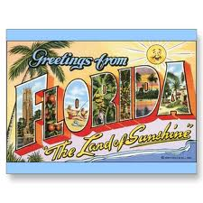
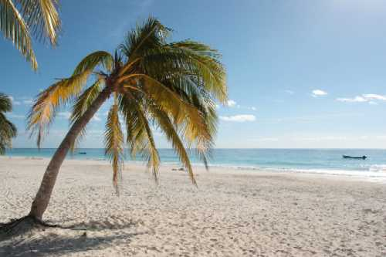
Florida
“The Sunshine State”
  Kevin Coogan
Notes:
Hi, my name is Kevin Coogan. I will be doing a presentation on Florida, “The Sunshine State”

Slide 2
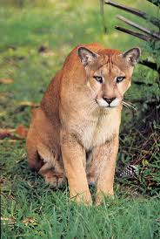
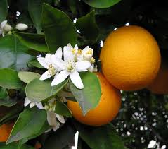
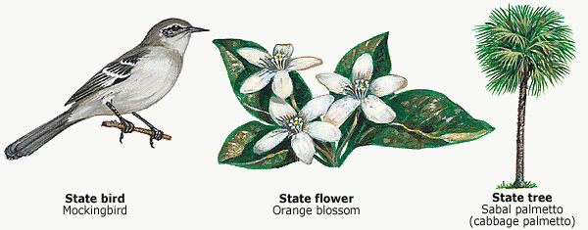
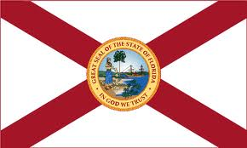
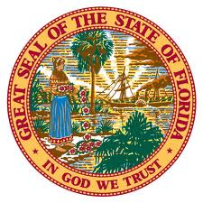
General Information
Capital
  Tallahassee
State tree
  Cabbage Palmetto
State flower
  Orange Blossom
State Animal
  Florida Panther
State Fruit
  Orange
State Bird
  Mockingbird
State Motto
  “In God We Trust”
Population
  15,982,378
State Flag
  Represents
    Sunshine
    Flowers
    Palm trees
    Rivers
    Lakes
Notes:
General Information: Florida is the fourth largest state in the US population wise, and has a population of 15,982,378. As seen from the seal in the middle of the flag, you can see that Florida’s state flag represents sunshine, flowers, palm trees, rivers, and lakes. Florida’s Capital is Tallahassee, its state tree is the Cabbage Palmetto, the state flower is the Orange Blossom, its state animal is the Florida Panther, its state fruit is the orange, the state bird is the mockingbird, and its state motto is “In God We Trust”.

Slide 3
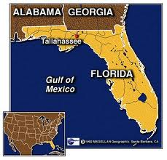
Location
Absolute Location
  30.457N. 84.281W.
Relative location
  North is Alabama and Georgia
  East is the Atlantic Ocean
  South are the Straits of Florida
  West is Alabama and the Gulf of Mexico
Notes:
Location: Florida's Absolute location is 30.457N. And 84.281W. For its relative location, North of Florida are Alabama and Georgia, east is the Atlantic Ocean, south of Florida are the Straits of Florida, and West of Florida is Alabama and the Gulf of Mexico.

Slide 4
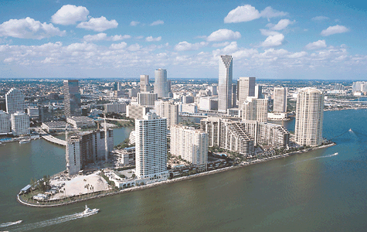
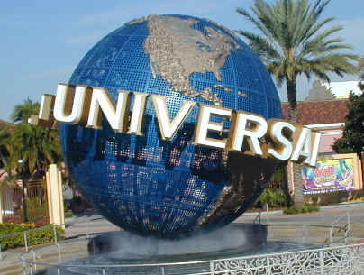
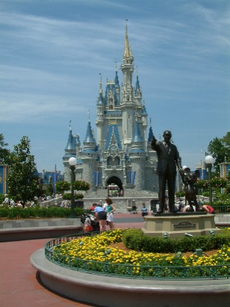
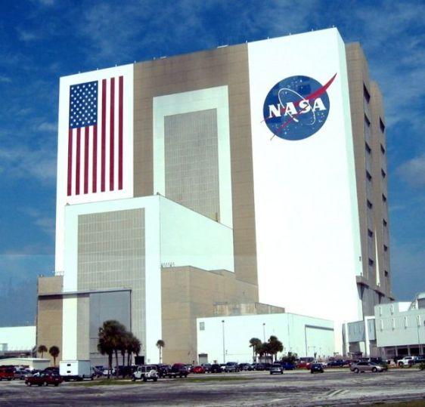
Place
Physical Features
  67.2 degrees is Tallahassee’s average yearly temperature
  Common Vacation spots
    Cities
      Miami
      Orlando
      Jacksonville
      Fort Lauderdale
      Tallahassee
      Tampa
    Beaches
    Attractions
      Disney World
      Universal Studios
      Kennedy Space Center
Cultural Features
  White persons
    79.4%
  Black Persons
    16.1%
  Asian
    2.4%
  Hispanic/Latino Origin
    21.5%
  White Persons Not Hispanic
    59.5%
Notes:
Place: Florida’s physical features include an average year round temp. of 67.2 degrees in Tallahassee. Florida is a common vacation spot because of cities such as Miami, Orlando, Jacksonville, Fort Lauderdale, Tallahassee, and Tampa, its various beaches, and also because of its attractions like Disney World, Universal Studios, and the Kennedy Space Center. Cultural features of Florida include 79.4% white persons, 16.1% black persons, 2.4% Asian, 21.5% Hispanic/Latino origin, and 59.5% white persons not Hispanic.

Slide 5
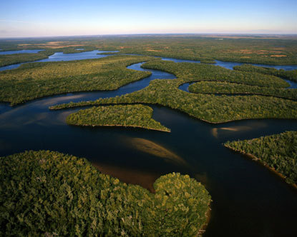
Place Continued
What does Florida look like?
  Highest Point
    Britton Hill
      345 feet above sea level
  US’s lowest high point
  Lowest Point
    Atlantic and Gulf Coasts
  National Forests
    Apalachicola
    Osceola
    Ocala
  Sub-tropical Wetlands
    Everglades
Notes:
Place Continued: What does Florida look like?: Florida's highest point is Britton Hill which is 345 feet above sea level, and is the US’s lowest high point. Its lowest point is the Atlantic and Gulf Coasts. Florida has three national forests including Apalachicola, Osceola, and Ocala. Florida also has sub-tropical wetlands called Everglades.

Slide 6
Florida Population
Notes:
Florida Population: The graph above shows that Jacksonville is the most heavily populated city in Florida, with 795,000 people in 2006, and 736,000 people in 2009. Jacksonville is then followed by Miami, Tampa, and then St. Petersburg.

Slide 7
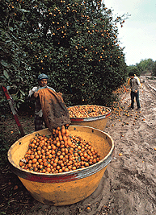
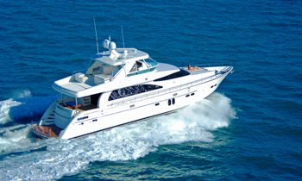
Human Environment Interactions
How do people interact with others in cities, farms and other communities?
  Farmers harvest citrus fruits
  Beaches are commonly visited
  Boating is very common and popular
  Many Celebrities Own Houses in Miami Such as:
    Dwayne Wade
    Hulk Hogan
    Jennifer Lopez
    Madonna
    Matt Damon
    Shaquille O’Neal
  Highest Cuban American Population in US
    Traditional foods include: rice, arroz con pollo, pan con bistec
    Often drink café cubano
    Most are Roman Catholic
Notes:
Human Environment Interactions: In Florida those who work on farms harvest citrus fruits. Beaches are commonly visited and are very popular in Florida, along with boating. Many Celebrities own houses in Miami, like Dwayne Wade, Hulk Hogan, Jennifer Lopez, Madonna, Matt Damon, and Shaquille O’Neal. Florida also has the highest Cuban American population in the US. Traditional Cuban foods include rice, arroz con pollo, and pan con bistic. Cuban Americans often drink a traditional drink called café cubano. Also, most Cuban Americans are Roman Catholic.

Slide 8
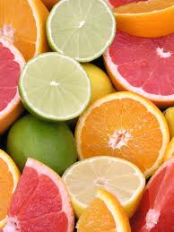
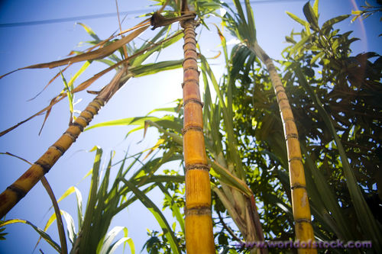
Movement
Imported/Exported goods
  Imports:
    Fruit Products
    Automobiles
  Exports:
    Citrus Fruits
    Vegetables
    Sugarcane
    Dairy products
    Nursery Stock
Notes:
Movement: Goods imported from Florida include fruit products, and automobiles. Florida’s exports include citrus fruits, vegetables, sugarcane, dairy products, and nursery stock.

Slide 9
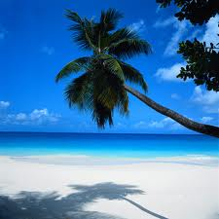
Regions
How is Florida different from RI?
  Florida has a warm year round climate
  Florida produces citrus fruits
  Florida is bigger than RI
  Bigger tourist attractions in Florida
  Both States Have Low High Points
    Rhode Island’s is 812 feet above sea level
    Florida’s is 345 feet above sea level
Notes:
Regions: How is Florida Different from RI?: Florida is different from RI because it has a year round warm climate, it produces citrus fruits, it is much bigger then RI, there are bigger tourist attractions in Florida. As a similarity, both states have low high points; RI’s being 812 feet above sea level, and Florida's being 345 feet above sea level.

Slide 10
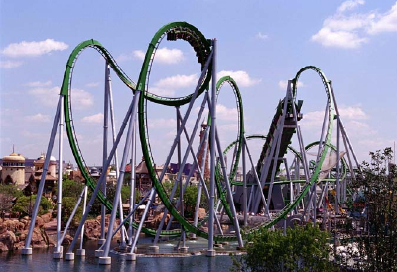
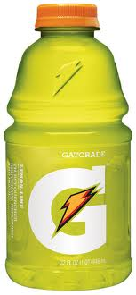
Fun Facts
Many Tourist Attractions
  Daytona Beach
  Disney World
  Universal Studios
  Everglades National Park
  Palm/West Palm Beach
Orlando
  Most tourists than any other amusement park destination in the US
Gatorade
  Made and developed for the University of Florida Gators
Sun Tan Lotion
  Invented in 1944 by Miami Beach pharmacist Benjamin Green
Florida’s Key West
  Highest year round temperature in the US
Sports Teams
  Baseball
    Florida Marlins
    Tampa Bay Rays
  Basketball
    Miami Heat
    Orlando Magic
  Football
    Jacksonville Jaguars
    Miami Dolphins
    Tampa Bay Buccaneers
  Hockey
    Florida Panthers
    Tampa Bay Lightning
Notes:
Fun Facts: There are many tourist attractions in Florida such as Daytona Beach, Disney World, Universal Studios, Everglades National Park, and Palm/West Palm Beach. Orlando attracts the most tourists than any other amusement park destination in the US. Gatorade was made and developed for the University of Florida Gators. Sun Tan Lotion was invented in 1944 by a Miami Beach pharmacist Benjamin Green, and Florida’s Key West has the highest year round temperature in the US. Professional sports teams in Florida include two baseball teams, the Florida Marlins and Tampa Bay Rays. For basketball there’s the Miami Heat and the Orlando Magic. For football there’s the Jacksonville Jaguars, the Miami Dolphins, and the Tampa Bay Buccaneers. There are also two professional hockey teams in Florida which are the Florida Panthers and the Tampa Bay Lighting.

Slide 11
Bibliography
Florida Article World Book Student. World Book, 2011. Web. 28 Mar. 2011. http://www.easybib.com/cite/form/website
"Florida Fast Facts and Trivia." 50states.com - States and Capitals. Marchex, Inc, 2011. Web. 25 Mar. 2011. http://www.50states.com/facts/florida.htm
"Florida QuickFacts from the US Census Bureau." State and County QuickFacts. 4 Nov. 2010. Web. 28 Mar. 2011. http://quickfacts.census.gov/qfd/states/12000.html
"Florida State Information - Symbols, Capital, Constitution, Flags, Maps, Song and More." 50states.com - States and Capitals. Marchex, Inc, 2011. Web. 25 Mar. 2011. http://www.50states.com/florida.htm
"Google Images." Google. Google, 2011. Web. 28 Mar. 2011. http://www.google.com/imghp?hl=en&tab=wi
"Site Map Page 2 - State Symbols USA." State Symbols USA - Official State and National Symbols, Emblems, Icons. Web. 28 Mar. 2011. http://www.statesymbolsusa.org/site-map-02.html#Anchor-FloridaSymbols
Notes:
These are the sources I used for my work.

Slide 12

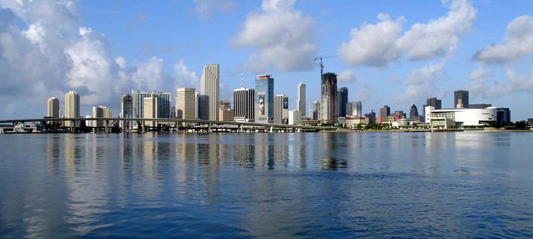

Thank you For Watching
Notes:
Thank you for watching my presentation on Florida.

