Slide 1
MEDICAL SPECIALISTS

Slide 2
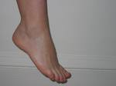
PODIATRIST Specialized in the study of the foot.

Slide 3
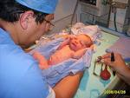
PEDIATRICIANS
Study the medical care of infants, and
teenagers

Slide 4
PYCHIATRIST
Specialized in the study of the body movement

Slide 5
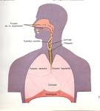
PULMONOLOGISTS They are doctors specialized in pulmononology and diseases of the lungs and respiratory tract

Slide 6
OBSTETRICIANS Specialized in the medical management of normal pregnancy and its complications, and the delivery of babies

Slide 7
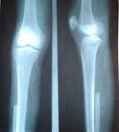
ORTHOPEDISTS
Focus on the skeletal system and treat bone diseases

