Slide 1
UNIVERSIDAD TECNOLÓGICA OTEIMA
POSGRADO Y MAESTRÍA EN DOCENCIA SUPERIOR
CURSO DE MATERIALES Y MEDIOS MULTIMEDIA
PRESENTADO POR:
AIDA MARIA POLANCO REYES

Slide 2
PHONETICS
Phonetics is the study of human speech sounds.
Phonetics (from the , phōnē, "sound, voice", ) is a branch of linguistics that comprises the study of the sounds of human speech. It is concerned with the physical properties of speech sounds (phones), and their physiological production, auditory perception, and neurophysiological status.

Slide 3
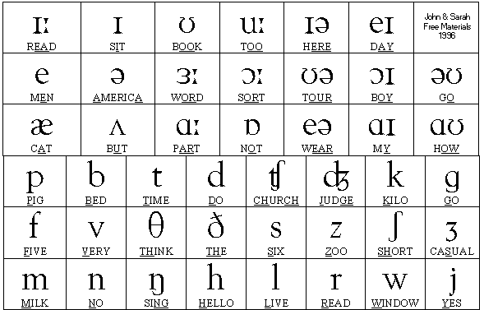
IPA
International Phonetic Alphabet
The general principle of the IPA is to provide one symbol for each distinctive sound (or speech segments)
The International Phonetic Alphabet is based on the Latin alphabet, using as few non-Latin forms as possible.

Slide 4
SYMBOLS AND SOUNDS
SYMBOLS: Represented with this symbol: “‹ ›”.
Example: The letter ‹b›.
SOUNDS: Represented by “[ ]”
Example: The sound [b].

Slide 5
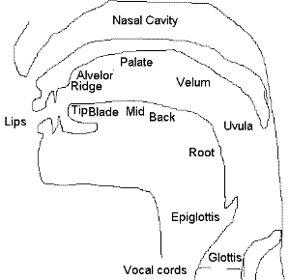
THE ARTICULATORY APPARATUS
In articulatory phonetics, the place of articulation (also point of articulation) of a consonant is the point of contact, where an obstruction occurs in the vocal tract between an active (moving) articulator (typically some part of the tongue) and a passive (stationary) articulator (typically some part of the roof of the mouth). Along with the manner of articulation and phonation, this gives the consonant its distinctive sound.

Slide 6
CONSONANTS - Place of articulation
Bilabial: between the lips
Labiodental: between the lower lip and the upper teeth
Dentolabial: between the upper lip and the lower teeth
Linguolabial: between the front of the tongue and the upper lip
Dental: between the front of the tongue and the top teeth
Alveolar: between the front of the tongue and the ridge behind the gums (the alveolus)
Retroflex: the tongue curls back so the underside touches the palate
Palatal: between the middle of the tongue and the hard palate
Velar: between the back of the tongue and the soft palate (the velum)
Uvular: between the back of the tongue and the uvula (which hangs down in the back of the mouth)
Glottal: at the glottis

Slide 7
Consonants – Manner of articulation
Voiced
Example:
[m], [b]
Voiceless
Example:
[p], [t]
Fricative
Example:
[f], [s]
Affricate
Example:
[Ĵ], [č]

Slide 8
IPA CHARACTERS AND VERBAL DESCRIPTION OF ENGLISH SOUNDS
SYMBOL | VERBAL DESCRIPTION | SOUND REPRESENTED
[b] | Voiced bilabial stop | Boy, aboe, crab
[p] | Voiceless bilabial stop | Pour, apt, slap
[d] | Voiced alveolar stop | Dock, adore, blood
[t] | Voiceless alveolar stop | Time, solitary, adept
[g] | Voiced velar stop | Game, agree, bag
[k] | Voiceless velar fricative | Cold, act, pock
[v] | Voiced labiodental fricative | Very, verage, shove
[f] | Viceless labiodental fricative | Fool, after, laugh
[θ] | Voceless interdental fricative | Thigh, ethereal, bath
[z] | Voiced interdental fricative | Zoo, azone, buzz
[s] | Voiceless alveolar fricative | Soup, blast,

Slide 9
IPA CHARACTERS AND VERBAL DESCRIPTION OF ENGLISH SOUNDS
[ž] | Voiced palatal fricative | Jacques, azure, beige
[Š] | Voiceless palatal fricative | Sure, mission, mash
[h] | Glottal fricative | Hope, ahoy
[Ĵ] | Voiced affricate (alveo palatal) | Jump, budget fudge
[č] | Voiceless affricate (alveo palatal) | Chocke, matchinh, itch
[m] | Bilabial nasal | My, ammonia, game
[n] | Alveolar nasal | Nice, plano, sun
[ŋ] | Velar nasal | Ink, song
[l] | Lateral voiced alveolar | Low, build, call
[r] | Voiced alveolar retroflex | Rough, sorry, chore
[w] | Bilabial glide | Why, away
[j] | Palatal glide | Yes, yoyo

Slide 10
GRACIAS

