Slide 1
VERTEBRATES AND INVERTEBRATES

Slide 2
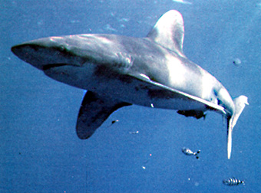
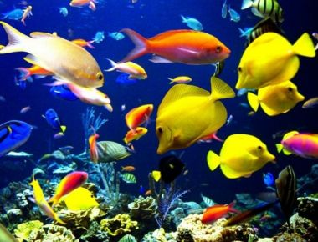
All animal can be classified as belonging to one of two groups:
Those with backbones Those without backbones
Animals without backbones are called Invertebrates
There are many different types of invertebrates:
Sponges
Are simple animals
Have no backbone
Anemones and Jellyfish
Have tentacles and stinging cells
All live in water
Feed themselves with their tentacles
Have no backbone
Worms
Snails, clams and octopuses
Often have shells
Have a head, foot and well developed organs
Have no backbone
Starfish and Urchins
Have a spiny body
Live on the bottom of the Ocean
Have no backbone
Insect, Spiders, Ticks, Lobsters, Crabs and Crayfish
Have a shell like covering called an exoskeleton
Have joined legs.
Have a segmented body
Animals with backbones are called Vertebrates
There are five groups of vertebrates:
Fish
Are cold-blooded
Live in water
Have backbone
These are fish:

Slide 3
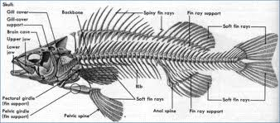
Fish have backbone:

Slide 4
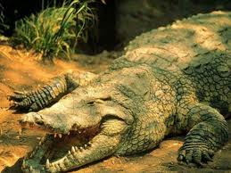
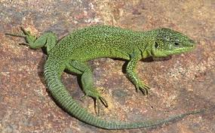
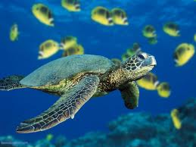
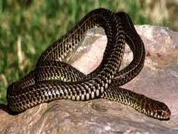
Reptiles
Have scales
Live on land
Are cold-blooded
Usually lay eggs
Have backbone
These are reptiles:

Slide 5
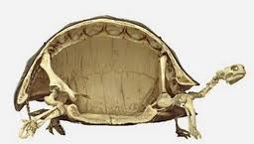
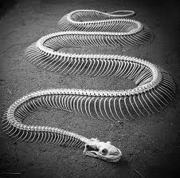
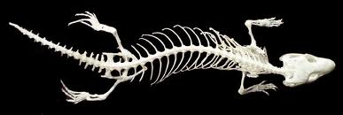
Reptiles have backbones:

Slide 6
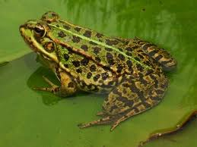
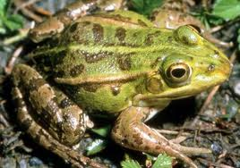
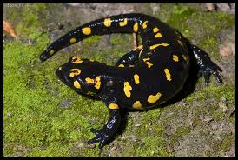
Amphibians
Are cold blooded
Live on land and in water
Have smooth skin
Lay eggs
These are amphibians

Slide 7
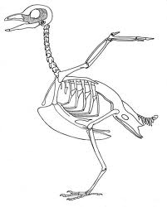
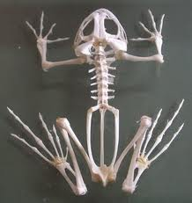
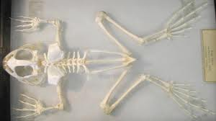
Amphibians have backbone:
Birds
Have feathers
Are warm-blooded
Have hollow bones and most can fly
Lay eggs
Birds have backbone:

Slide 8
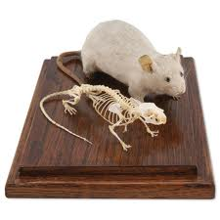
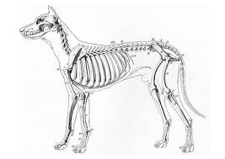
Mammals
Have hair or fur
Are warm-blooded
Feed milk to their young
Bear live young (except monotremes)
Mammals have backbones

Slide 9
VERTEBRATES
Invertebrates Animals without a Backbone or Spinal Column: | Vertebrates Animals with a Backbone or Spinal Column: (All these animals are in the phyla Chordata and the subphyla Vertebrata.)
Animals with an internal skeleton made of bone are called vertebrates. Vertebrates include fish, amphibians, reptiles, birds, mammals, primates, rodents and marsupials.
Although vertebrates represent only a very small percentage of all animals, their size and mobility often allow them to dominate their environment.
Click on the picture or name of the animals below for more information.

Slide 10
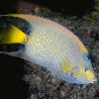
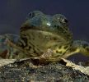
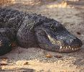
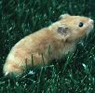
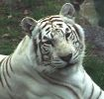
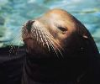
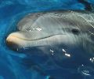
Fish | Amphibians | Reptiles
Mammals | Primates | Rodents
Marsupials | Whales and Dolphins | Seals

Slide 11
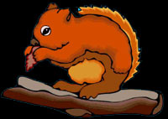
Mammals |  |  |  |  | Molluscs
Birds |  |  |  |  | Worms
Reptiles |  |  |  |  | Arthropods
Amphibians |  |  |  |  | Echinoderms
Fish |  |  |  |  | Coelenterates

Slide 12
We are vertebrates and have a skeleton to keep us upright and to help us to move.

Slide 13
MAMMALS Warm blooded vertebrate animals which have hair or fur. Retain the young in their bodies until they are ready to be born. When the young are born they are fed by the mother on milk. Mammals have a highly developed nervous system. They live on land and in the sea. There is a very wide range of types in this group. The largest mammal is the blue whale which often exceeds 30m in length. Shrews, mice and mice which are the smallest are often less than 5cm, excluding their tail. Human beings are mammals.
VERTEBRATES ARE ANIMALS WITH BACKBONES

Slide 14
BIRDS Warm blooded vertebrate animals with wings and bodies covered with feathers for warmth and to help them to fly. Birds have lungs for breathing and a heart with four chambers. All adult birds are covered in feathers even though some are born naked. The female lays the eggs and the young hatch from these. The young are cared for by the adult birds until they are old enough to fend for themselves.
The female lays the eggs and the young hatch from these. The young are cared for by the adult birds until they are old enough to fend for themselves.

Slide 15
REPTILES Cold blooded vertebrates. This means they cannot maintain a body temperature much different than their environment. Most reptiles lay eggs with hard shells. Young fully formed reptiles hatch from the eggs. Reptiles usually lay their eggs in sand. Some snakes and lizards retain their eggs in their body and give birth to live young. Young reptiles have to care for themselves from the time they hatch. A reptile's skin is usually covered with scales. Reptiles have been on earth for over 300 million years - that is a very long time!

Slide 16
AMPHIBIANS Cold blooded vertebrate animals that generally spend their larval or tadpole stage in fresh water. They do not transfer to the land until they are mature, returning to the water to breed. Amphibians were the first animals to venture on to land. They emerged from the oceans over 300 million years ago. Frogs, toads and salamanders are amphibians.
venture on to land. They emerged from the oceans over 300 million years ago. Frogs, toads and salamanders are amphibians.

Slide 17
FISH Cold blooded vertebrate animals that live in water and use gills to obtain oxygen. Fish live in both fresh and salt water and can be found all over the world, except in some very hot larval springs and the Dead Sea because it is too salty.

Slide 18
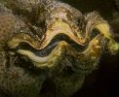
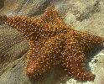
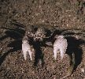
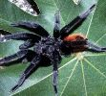
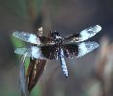
INVERTEBRATES
Of the million or more animal species in the world, more than 98% are invertebrates. Invertebrates don't have an internal skeleton made of bone. Many invertebrates have a fluid-filled, hydrostatic skeleton, like the jelly fish or worm. Others have a hard outer shell, like insects and crustaceans. There are many types of invertebrates. The most common invertebrates include the protozoa, annelids, echinoderms, mollusks and arthropods. Arthropods include insects, crustaceans and arachnids.
Protozoa | Annelids | Mollusks | Echinoderms
Crustaceans | Arachnids | Insects

Slide 19
WORMS These are animals whose bodies are divided into a number of similar rings. The head tapers to a point. The tail is broad and flat. Pores on the skin cover its body with slime. This slime keeps the worm clean, makes it slippery and kills germs. The pointed nose drills into the soil and the flat tail presses it tight. The slime is then used to cement the burrows.

Slide 20
ECHINODERMS Echinoderm is a common name for about 6 000 living species that live at all depths in all of the oceans of the world . These include: Starfish, sea-cucumbers and sea-urchins. Starfish have a mouth surrounded by 5 arms. At the ends of the arms are fleshy tube feet which the starfish uses to cling to things and to crawl about. Sea-urchins have spines that are very well developed. Echinoderms have simple nervous and circulatory systems.

Slide 21
This is the common name for 9 000 species of invertebrate animals found in all oceans of the world.
These include:
Coral, jellyfish and sea-anenome.
Some are cylindrical with the mouth and tentacles at one end.
Jellyfish look like an opened umbrella with tentacles hanging.
All coelenterates capture their prey in the tentacles and then kill them with poison from the stinging organ.

