Slide 1
WHO IS HOWARD GARNER?

Slide 2
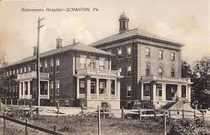
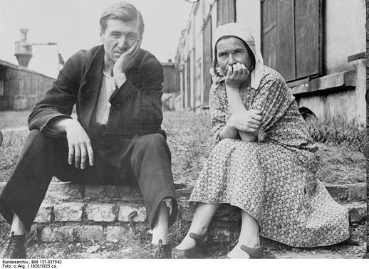
HOWARD GARNER….BIOGRAPHY
He was born in SCRANTON, PA in 1943.
His parents were refugees from Nazi Germany.

Slide 3
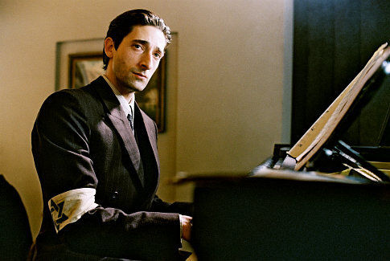
As a child , he was avid reader and loved music and He became a gifted pianist…

Slide 4
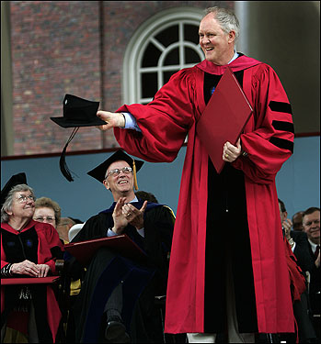
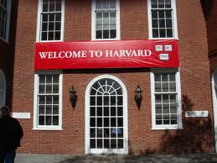
He enrolled at Harvard University being young and He started out as a History major and was eventually led to cognitive developmental Psychology.

Slide 5
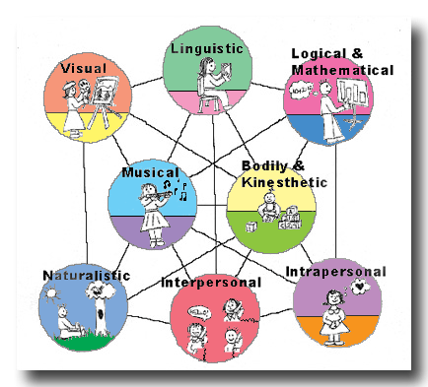
In 1983, he developed the theory of multiple intelligences for which is widely known.

Slide 6
Involve in school reform since the 1980s.

Slide 7
He is married to Ellen Winner, a developmental psychologist.
He has four sons and one grandchild-
His passions are his family and his work.
He enjoys to travel and the arts.

Slide 8
books
HOWARD GARNER HAS AUTHORED MORE THAN 20 BOOKS.
BESTSELLER BOOKS.
FIVE MINDS FOR THE FUTURE
MULTIPLE INTELLIGENCES: NEW HORIZONTS IN THEORY AND PRACTICE
FRAMES OF MIND:THE THEORY OF MULTIPLE INTELLIGENCES.

