Slide 1
MULTIPLE INTELLIGENCES
COURSE
English for specific purpose
PROFESSOR:
ILEANA RODRIGUEZ B.

Slide 2
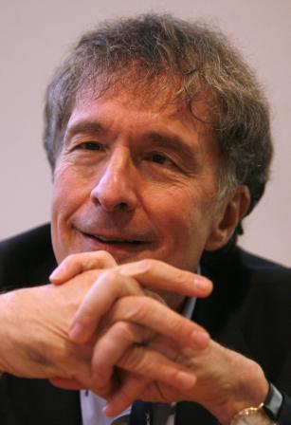
TEORIA DE HOWAR GARDNER
Intelligence is not something unitary, which group different specific capacities, but it must be seen as a whole of different and independent multiple intelligences.

Slide 3


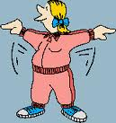
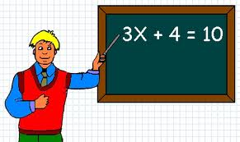
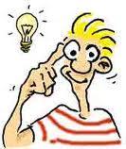


MULTIPLE INTELLIGENCES SCHEMA
Linguistic
Logical - Mathematic
Musical
Intrapersonal
Interpersonal
Bodily – Kinestethic
Spatial
Fin

Slide 4
Linguistic Intelligence
Linguistic Intelligence is defined as having the following criteria:
a deep understanding of words and a sensitivity to the literal and figurative meanings of words,
highly developed oral and written communication skills,
knowledge of grammar rules and when it is appropriate to disregard those rules,
sensitivity to the musical qualities and rhythms of words,
knowledge of the many different uses for language, such as persuasion, information, or pleasure.
Poets, writers, and public speakers are examples of linguistically intelligent people.
  Maya Angelou, William Shakespeare, and Abraham Lincoln are famous examples of linguistically intelligent people.
Inicio

Slide 5
Logical – Mathematical Intelligence
Logical-Mathematical Intelligence is defined as having the following criteria:
Logical-Mathematical Intelligence is defined as having the following criteria:
an ability to understand numbers and logical concepts well,
an ability to perceive numerical and logical patterns,
possession of highly developed reasoning skills,
an understanding of abstract analysis and functions.
Physicists, computer programmers, and business executives, such as accountants, are examples of logical-mathematically intelligent people.
Albert Einstein and Bill Gates are famous examples of people with strengths in this intelligence.
Inicio

Slide 6
Musical Intelligence
Musical-Rhythmic Intelligence is defined as having the following criteria:
an ability to discern and express musical forms,
sensitivity to rhythm, pitch, meter, tone, or melody,
sensitivity to timbre, or a highly developed ability to distinguish the sound of a violin from that of a flute, viola, human voice, or cello.
Composers, musicians, and conductors are examples of careers for musically intelligent people.
Beethoven, cellist Yo Yo Ma, and conductor Arturo Toscanini are famous examples of musically intelligent people.
Inicio

Slide 7
Bodily – Kinesthetic Intelligence
Bodily-Kinesthetic Intelligence is defined as having the following criteria:
highly developed coordination, balance, dexterity, strength, speed, and flexibility,
expertise in using the entire body to relate thoughts and feelings,
an ability to manipulate objects skillfully, using both fine and gross motor movements.
Dancers, football players, and gymnasts are examples of bodily-kinesthetic intelligence.
Classmate and dancer Camille Dieterle, football player Joe Montana, and Olympic gymnast Kerrie Strug are examples of people with this intelligence.
Inicio

Slide 8
Spatial Intelligence
Visual-Spatial Intelligence is defined as having the following criteria:
sensitivity to the relationship between line, color, shape, space, and form,
an ability to manipulate and mentally rotate objects,
the capacity to create a graphic likeness of a real object,
the ability to understand the components of visual and spatial displays within the graphic arts.
Graphic artists, architects, and map-makers are examples of spatially intelligent jobs.
People who excel at reading maps, playing chess, drawing diagrams and illustrations, reparing machinery, understanding geometry, and completing jigsaw puzzles are spatially intelligent.
Inicio

Slide 9
Intrapersonal Intelligence
Intrapersonal Intelligence is defined as having the following criteria:
highly developed self-knowledge, defined as having accurate knowledge of one’s dreams, goals, strengths, limitations, moods, anxieties, desires, and motivations,
the ability to act on the basis of self-knowledge, creating environments, guiding behavior, and making decisions based on an accurate picture of oneself.
People that have intrapersonal intelligence know themselves well. They aren’t forced into molds, and they make decisions based on what is right for themselves. They possess a strong sense of identity and purpose.
Inicio

Slide 10
Interpersonal Intelligence
Interpersonal Intelligence is defined as having the following criteria:
an ability to perceive and make distinctions in the moods, characteristics, intentions, temperaments, motivations, and feelings of other people,
a sensitivity to those distinctions, acknowledged by treating each individual with their personal distinctions in mind
Those who have highly developed interpersonal intelligence are successful leaders, bosses, public speakers, and military officers.
Martin Luther King Jr., Franklin Roosevelt, and Norman Schwartzkopf are famous examples of successful people with interpersonal intelligence.
Inicio

Slide 11
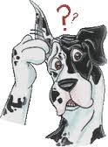
What kind of intelligence do you have?

