Slide 1
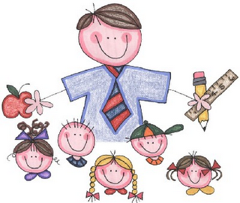
Universidad Tecnológica Oteima
Centro de Posgrados y Maestrías
Sustentación Final
Por:
Stayce J. Rodríguez

Slide 2

Inspirational Thought

Slide 3

Speaking in Public
How do you feel?

Slide 4
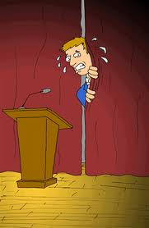
1. Admit Nervousness
All you have to do is admit that you are a bit nervous speaking to your audience. When you do this, the audience will be more forgiving if your nervousness shows up later on.

Slide 5

2. Redefine your Audience
Instead of seeing them as lecturers who are evaluating you, maybe you can convince yourself that they are all fellow students who are in queue to present after you.

Slide 6

3.Invest in visual aids
Imagine a
presentation
with beautiful
PowerPoint slides and
even more impressive
notes given to each
of
your audience
members.

Slide 7
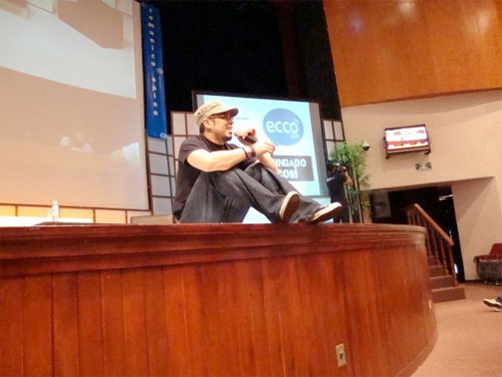
4. Make mistakes intentionally
Drop notes on the floor, in this way your going to make them laugh.

Slide 8

5. To speak to a person at a time
To overcome this, you just need to speak to one person at a time.
Choose one member of your audience and dedicate your whole presentation to him or her.

