Slide 1
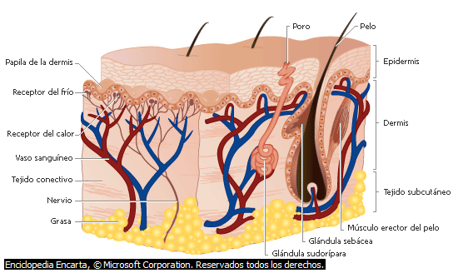
EPIDERMIS

