Slide 1
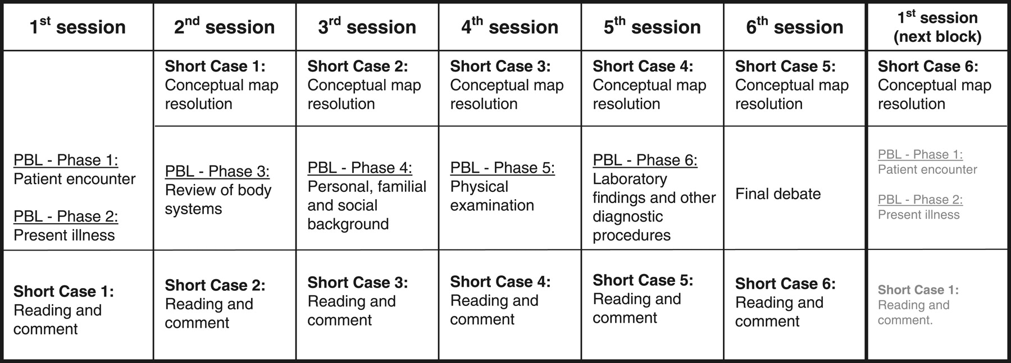
Toward meaningful learning in undergraduated medical education
using concept maps in a PBL pathophysiology course
Standard timetable of the sessions covering one block (each session lasted 2 h and occurred twice a week).
Rendas A B et al. Advan in Physiol Edu 2006;30:23-29
©2006 by American Physiological Society
Notes:
Standard timetable of the sessions covering one block (each session lasted 2 h and occurred twice a week). PBL, problem-based learning.

Slide 2
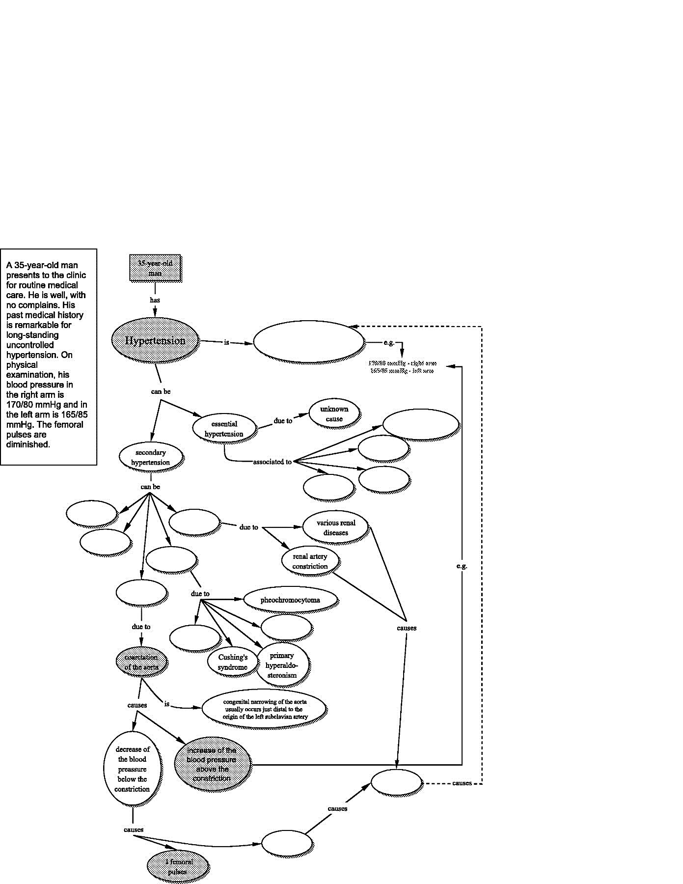
Section of a concept map of hypertension
Toward meaningful learning in undergraduated medical education
using concept maps in a PBL pathophysiology course

Slide 3
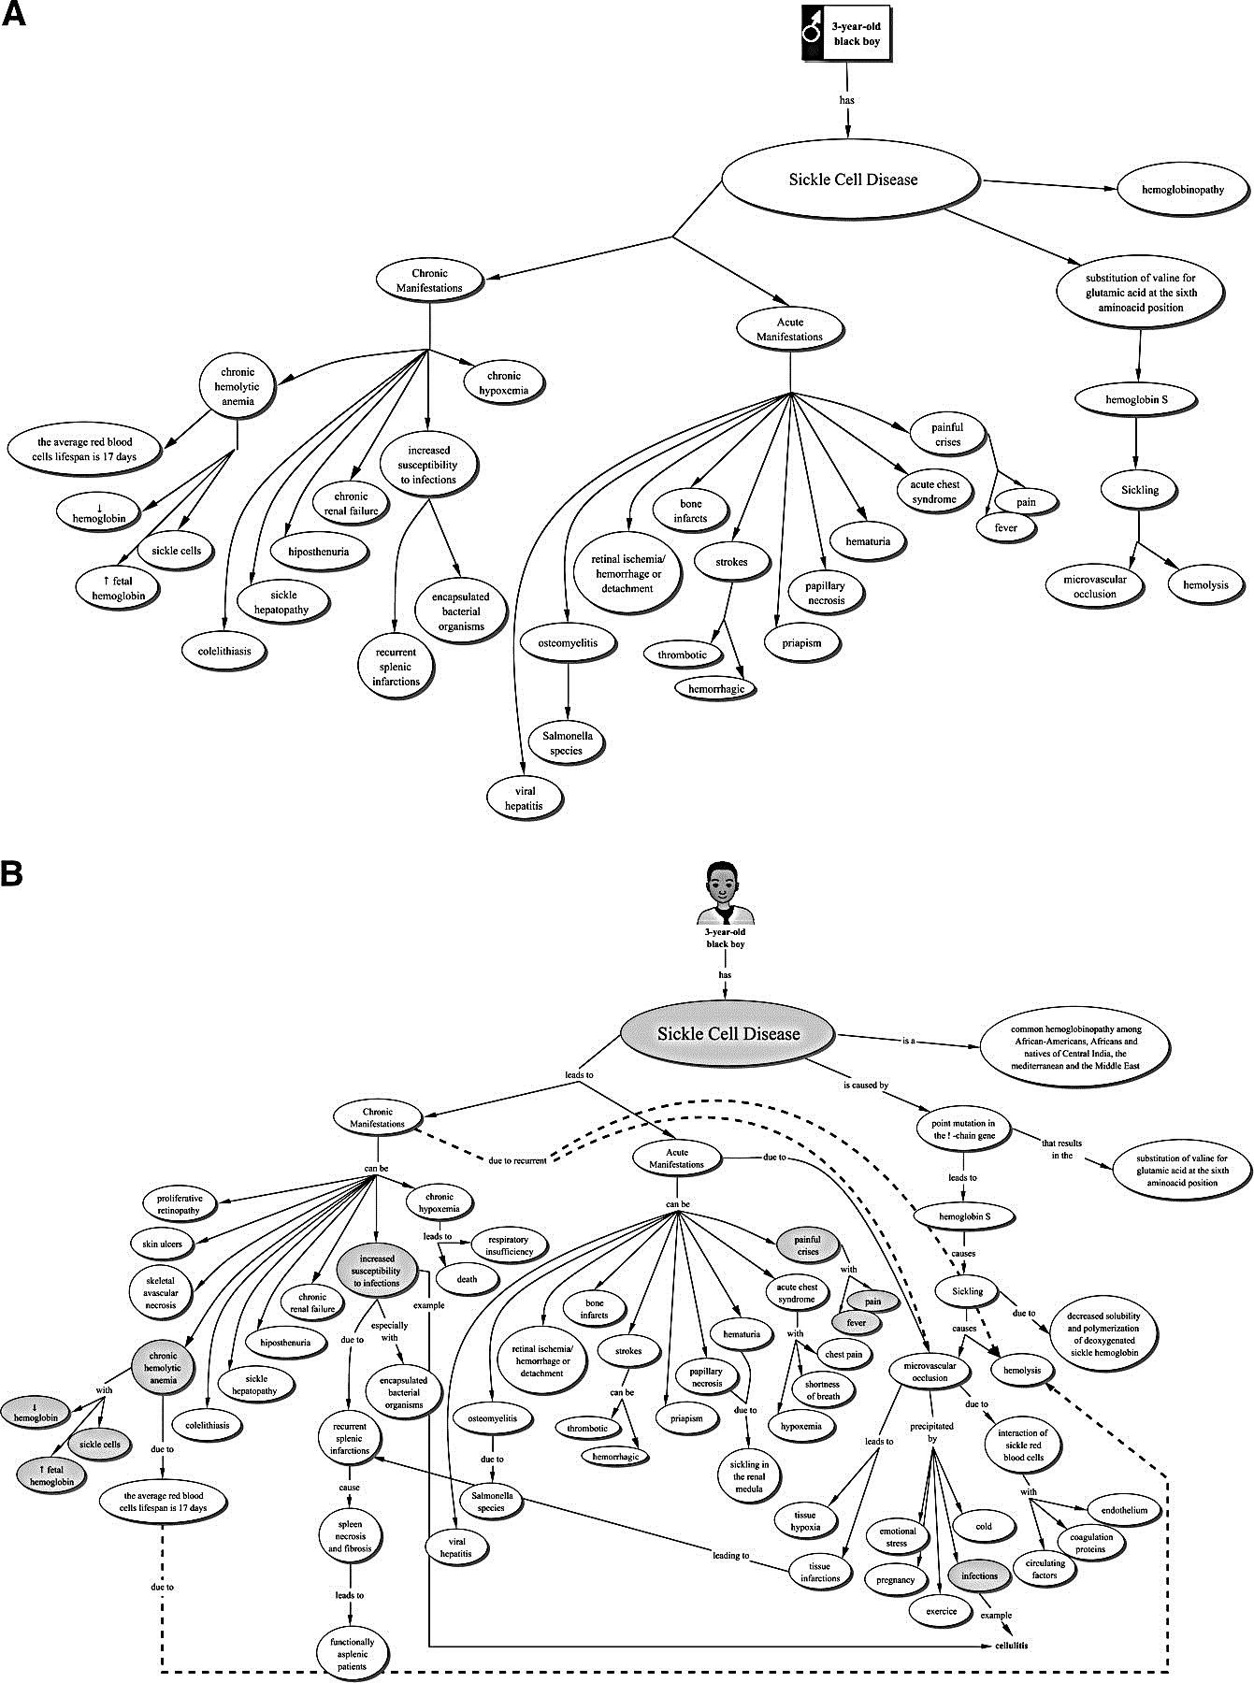
Toward meaningful learning in undergraduated medical education
using concept maps in a PBL pathophysiology course
construction of a concept map related with the long case (initial stage)

Slide 4
Toward meaningful learning in undergraduated medical education
using concept maps in a PBL pathophysiology course
construction of a concept map related with the long case (final stage)

