Slide 1
Integrated circuits(IC)
The bipolar processes, coupled with thin film resistors and laser wafer trim technology, led to the proliferation of IC.The CMOS and bipolar processes were combined to achieve both low power high-density logic and high accuracy low noise analog circuitry on a single chip.
For higher power applications, thin-film, thick-film, and hybrid ICs may be used.
An IC fabricated on the CMOS or complementary bipolar processes has fixed input ranges that are usually at least several hundred mill volts from either rail.
Small-scale integration (SSI) of IC refers to fewer than 10 integrated components, medium-scale integration (MSI) to between 10 and 100 components, and large-scale integration (LSI) to more than 100 integrated components.

Slide 2
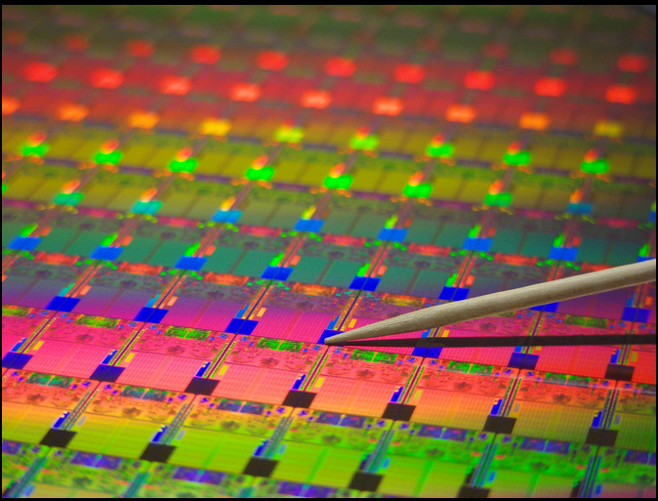
Structure of integrated circuits
Integrated circuit (IC) chips are manufactured on silicon wafer. Transistors are placed on the wafers through a chemical etching process.
Each wafer is cut into chips (dies),which are then packaged individually.

Slide 3
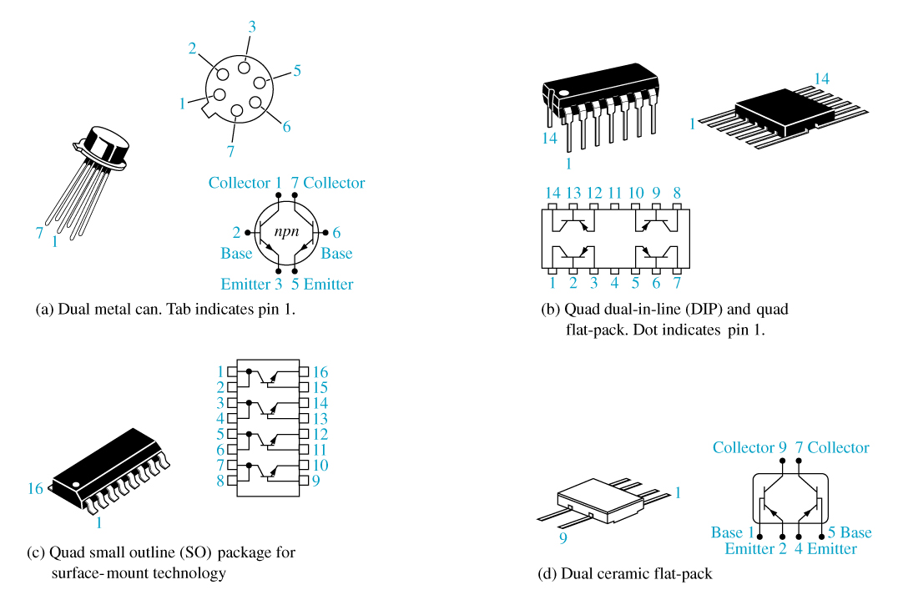
Typical BJT Integrated Circuits

