Slide 1
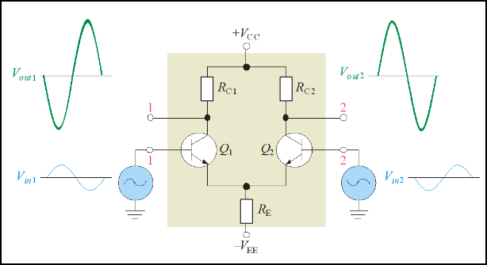
Differential amplifier
A differential amplifier (diff-amp) has two inputs. It amplifies the difference in the two input voltages. This circuit is widely used as the input stage to operational amplifiers. Differential-mode inputs are illustrated.

Slide 2
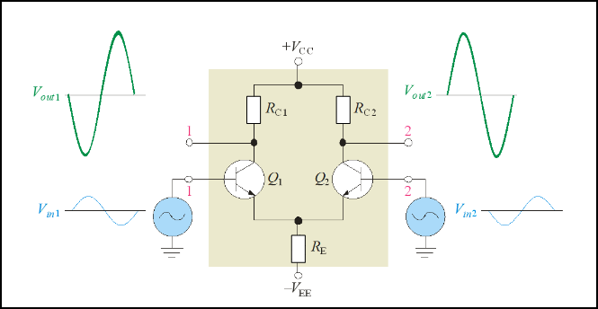
The same amplifier as in the last slide now is shown with common-mode inputs. Diff-amps tend to reject common-mode signals, which are usually due to noise. Ideally, the outputs are zero with common-mode inputs.

