Slide 1
LET’S READ AND WRITE
NAME:
GRADE:
SCHOOL:

Slide 2
You can do the following activities by using Word Art.

Slide 3
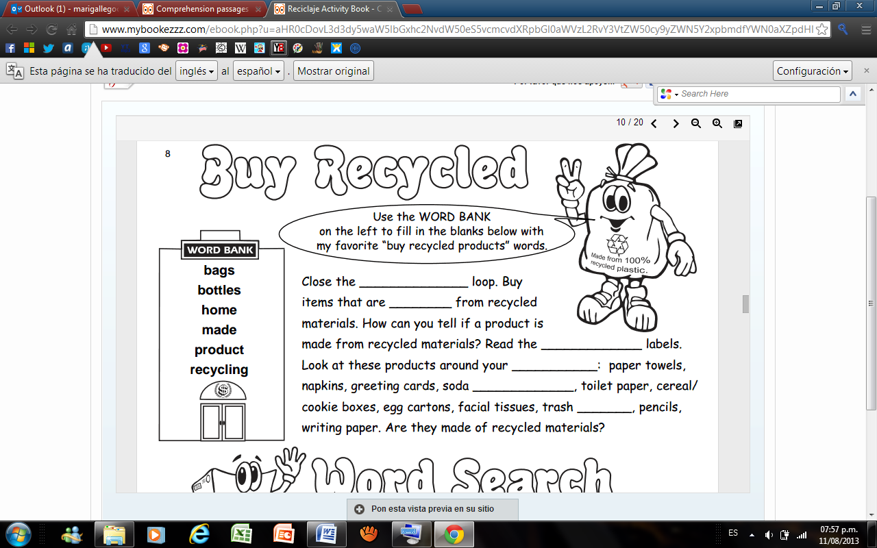

Slide 4
