Slide 1
Different Reading Techniques And When To Use Them

Slide 2
INTRODUCTION
Profa. Quetzalide Martínez
Cel: 68034112
E-mail: marelm0206@gmail.com

Slide 3
International’s Women Day

Slide 4
Motivational quote

Slide 5
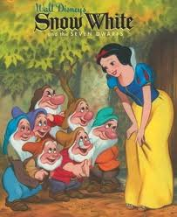

Slide 6
The four main types of reading techniques are the following:
Skimming
Scanning
Intensive
Extensive

Slide 7
Skimming
What is skimming?

Slide 8
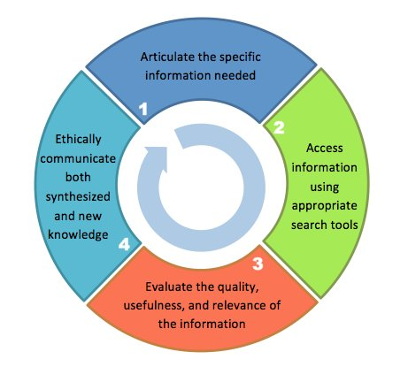
Skimming
Running the eyes over quickly, to get the gist

Slide 9
Scanning
What is scanning?

Slide 10
Scanning
Looking for a particular piece of information.

Slide 11
Extensive reading
What is extensive reading?

Slide 12
Extensive reading
Longer texts for pleasure and needing global understanding.

Slide 13
Intensive reading
What is intensive reading?

Slide 14
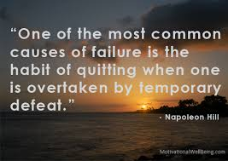
Intensive reading
Shorter texts, extracting specific information, accurate reading for detail.

Slide 15
Skimming - running the eyes over quickly, to get the gist
Scanning - looking for a particular piece of information
Extensive reading - longer texts for pleasure and needing global understanding
Intensive reading - shorter texts, extracting specific information, accurate reading for detail.
http://www.learningtolearn.group.shef.ac.uk/read/read_difkind_task.html

Slide 16
The ‘What’s On’ section of the local paper:
Skimming
Scanning
Extensive
Intensive

Slide 17
A novel
Skimming
Scanning
Extensive
Intensive

Slide 18
A newspaper
Skimming
Scanning
Extensive
Intensive

Slide 19
Find the topic sentences

Slide 20
Guessing meaning from context (new words)

Slide 21
Guessing meaning from context (new words)
Literal meaning
Figurative meaning

