Slide 1
Athabasca University MHST/NURS 603
Facilitating Inquiry: Assignment 3 Group D
Nursing Absenteeism
Cheryl Levi, BScN, RN(EC), PHC-NP
Brenda Henke, RN, BAA(N)
Jamie Hernandez, BScN, RN

Slide 2
Purpose of the study- Research Question
To explore the perceived factors that contribute to nursing absenteeism and identify factors that promote or hinder job satisfaction

Slide 3
Methodology
a mixed method design study was conducted using:
An on-line focus group
An on-line survey

Slide 4
Historically Speaking
Lack of consensus in literature
  defining nursing absenteeism
  factors contributing to nursing absenteeism
  determinants of nursing absenteeism are inconsistent
Ayon, 2015; Daouk-Öyry, Anouze, Otaki, Dumit, & Osman, 2014; Davey et al, 2009

Slide 5
Systematic Review
Davey et al. (2009)
Systematic review: results identified 70 independent variables that may influence nursing absenteeism
  3 common themes:
    Work attitudes
    Retention factors
    Job stress and burnout

Slide 6
Hypothesis
The objective of this study was to explore the factors that contribute to nursing absenteeism and how it influences job satisfaction.
The null hypothesis of this study is that there is no relationship between nursing absenteeism and job satisfaction that can be proven at a statistically significant level with the data obtained.

Slide 7
Subproblems
How prevalent is it?
What factors contribute to it?
How do colleagues interpret absenteeism?
What are the systemic implications of absenteeism?
What potential solutions exist to manage absenteeism constructively?

Slide 8
Definition of terms
Absenteeism - the failure to report to work as scheduled and includes voluntary and involuntary absences whether or not they were planned.
Magee, Caputi, & Lee (2016; as cited in Johns, 2008)

Slide 9
Voluntary absenteeism
Voluntary absenteeism
    external factors influencing an employee’s ability to attend work
    choosing to withdraw from work or escape from a negative work environment.
    may be a way of escaping, avoiding, or compensating for adverse, demoralizing, or stressful work environments (i.e. bullying)
Magee, C. A., Caputi, P., & Lee, J. K. (2016).

Slide 10
Involuntary Absenteeism
Involuntary absenteeism
  also known as sickness absenteeism
  refers to instances where employees do not attend work due to poor physical or mental health
  often considered ‘legitimate’ use of sick time
Magee, C. A., Caputi, P., & Lee, J. K. (2016).

Slide 11
Results of focus group
Reduced job satisfaction by the absentee and remaining staff
Increased costs to organization
Denial of vacation time or educational leave
Inability to switch shifts due to skill level requirements
Inadequate staffing ratios
Reduction in positive patient outcomes

Slide 12
Results of focus group - effects of Nursing Absenteeism
Financial implications to individuals, units, organizations and the health care system leads to increased direct and indirect costs.
Impacts the quality of care and leads to negative patient outcomes.
(Davey, Cummings, Newburn-Cook, & Lo, 2009)

Slide 13
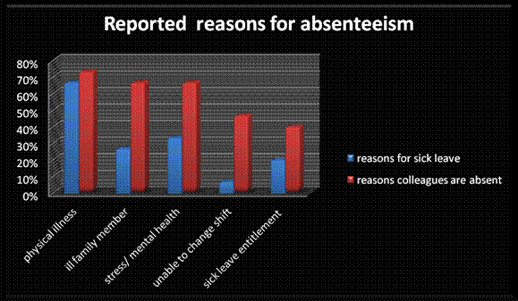
Stimulus for Absenteeism

Slide 14

How does your workplace measure up?
Negative work environments are toxic and can lead to an increased rate of employee absences

Slide 15
Nursing Absenteeism
Reasons for nursing absenteeism:
Personal physical illness (legitimate cause) however frequency may become the issue
Ill family member
Stress or mental health issue
Unable to switch or change a shift
Perception that one is entitled to sick leave

Slide 16
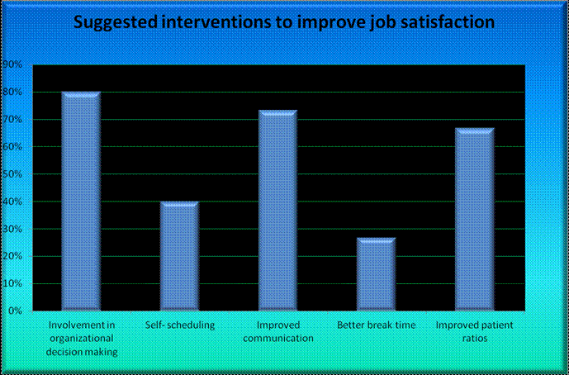
Survey results - Job Satisfaction

Slide 17
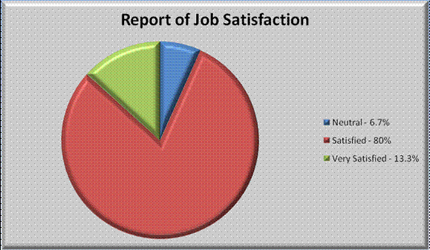
Survey results – Percentage of participants reporting of Job Satisfaction

Slide 18
Predicting Absenteeism
The greatest predictor of absenteeism is prior poor attendance (Davey et al., 2009).

Slide 19
Stimulus For Poor Attendance
Qualitative analysis from the focus group indicates absenteeism results from:
  Increased work demands, demanding patients
  Reduced or ineffective managerial support
  Equipment failure or insufficient materials/equipment to perform required tasks
  Inadequate staffing, improper staffing ratios
  Lack of other resources and support
Farquharson, Allan, Johnston, Johnston, Choudhary, & Jones (2012)
Group D focus group results (2016)

Slide 20
Stimulus For Poor Attendance
Family demands such as inadequate or unavailable child care or elder care.
Denial or anticipated denial of vacation requests
Denial of leave for self or professional development activities or endeavours
Bullying in the workplace
Organizational commitment and culture (McNeese-Smith, 1995; Zboril-Benson, 2002)

Slide 21
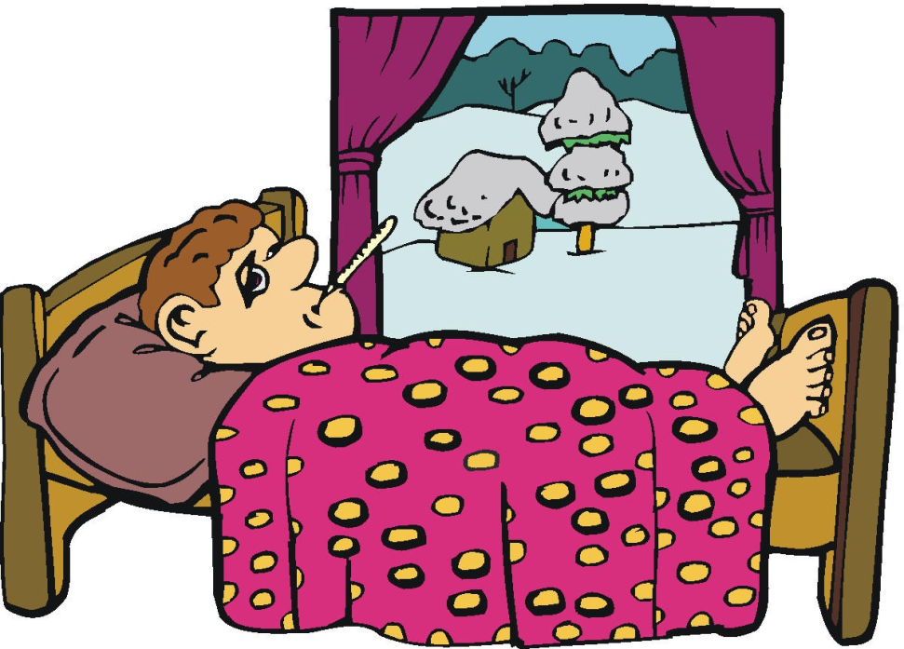
Involuntary Absenteeism
Also known as “sickness” absenteeism
  refers to instances where employees do not attend work due to poor physical or mental health
Magee, C. A., Caputi, P., & Lee, J. K. (2016).
https://ashscrapyard.wordpress.com/2012/09/29/it-has-been-a-sick-week-literally/

Slide 22

Voluntary Absenteeism
Notes:
Retrieved from: https://www.google.ca/url?sa=i&rct=j&q=&esrc=s&source=images&cd=&cad=rja&uact=8&ved=0ahUKEwikzsuxltzLAhVFsIMKHYs6BR4QjB0IBg&url=http%3A%2F%2Fwww.123rf.com%2Fphoto_29478261_silhouettes-of-people-partying-outdoors.html&psig=AFQjCNE1YGBZgw7U-by9H9_giL-ETA2Kjw&ust=1459006201173214

Slide 23
Nursing Absenteeism
How prevalent is it?
What factors contribute to it?
How do colleagues interpret absenteeism?
What are the systemic implications of absenteeism?
What potential solutions exist to manage absenteeism constructively?

Slide 24
Prevalence of Nursing Absenteeism
18,900 of 251,500 or 7.5% of Registered Nurses and Nurse Supervisors were absent from work in 2012 due illness or disability according to the Canadian Federation of Nurses Unions (CFNU) (2013)
According to The Ottawa Hospital (2016) and CFNU (2013) absentee rates are closer to 13.8 days per full time employee (nurse) per year

Slide 25
How Sick Are Nurses?
“Within Canada, full-time nurses rate of absenteeism is 58% higher than the average Canadian full-time worker with 12 days of work a year missed compared to 7 days used by employees in other fields for illness or disability” (Gaudine, Saks, Dawe, & Beaton, 2013).

Slide 26
Nursing Absenteeism
Reasons for nursing absenteeism in acute care settings
  Personal physical illness (legitimate cause) however frequency may become the issue
  Ill family member
  Job or personal stress, mental health issue(s), burnout
  Unable to switch or change a shift
  Denial of vacation, leave of absence
  Perception that one is entitled to sick leave
(from qualitative data analysis)

Slide 27
Nursing Absenteeism
Literature indicates:
determinants of nursing absenteeism are inconsistent, diverse perceptions of nursing absenteeism exist and more research is required to identify methods to reduce nursing absenteeism.
(Ayon, 2015; Daouk-Öyry, Anouze, Otaki, Dumit, & Osman, 2014; Davey, et al., 2009)

Slide 28
Perception of Others

Slide 29
Lab 1
Methodology
Participants were selected from the course MHST/NURS 603 Facilitating Inquiry winter session 2016.
Procedure: 6 focus group questions were developed by the three members of Group D and analyzed to explore perceived factors contributing to nursing absenteeism and job satisfaction. Online participation was arranged and definitions developed for clarity of the group members.

Slide 30
Lab 1
Ethical approval was not required and the questions were approved by the course instructor. Anonymity was maintained by assigning numbers to the participants.
Limitations that affected the rigor and strength of the study:
  Sample size
  Inability to saturate the data
  Limited cross-section of roles of participants affecting generalizability
  Geographical distance and time constraints
  Absence of personal interactions preventing non-verbal cues and observations of reactions of others

Slide 31
Lab 1
Analysis: common themes were identified and coded manually resulting in broad categories of job satisfaction or dissatisfaction, burnout or stress, retention factors, and work attitudes.

Slide 32
Lab 1
Results
The analysis of the focus groups identified issues relating to each of the following factors:
  Absenteeism
  Retention and recruitment
  Workplace attitudes
  Satisfying aspects of work life
  Strategies to reduce nursing absenteeism
  The negative impact of nursing absenteeism

Slide 33
Lab 1
Discussion
The group agreed that nursing absenteeism negatively affects the health care system, other employees and patient outcomes and that it is a multifactorial problem. The group’s finding are consistent with the literature (Lavoie-Tremblay, Wright, Desforges, Gelinas, Marchionni & Drevniok, 2008).

Slide 34
Impact of Absenteeism
Reduced job satisfaction by the absentee and remaining staff
Increased costs to organization and health care system
Denial of vacation time or educational leave
Inability to switch shifts due to skill level requirements
Inadequate staffing ratios
Reduction in positive patient outcomes

Slide 35
Job Satisfaction
Job satisfaction
  defined as the workers self-reported level of contentment toward their work and the working environment
Ma, Samuels, & Alexander (2003).

Slide 36
Job Satisfaction
Factors contributing to job satisfaction
    Effective communication
    Teamwork
    Commitment to the organization and
    The ability of the individual to identify with the organization’s culture
    Job involvement leading to increased satisfaction
(Joyce, Pabayo, Critchley, & Bambra, 2010; Ruotsalainen, Verbeek, Marine, & Serra, 2015)

Slide 37
Lab 2: Survey and quantitative analysis
Methodology: convenience sampling was used from the same class identified in Lab 1. Participants were requested to complete an online survey (Fluid surveys) voluntarily regarding their perceptions of nursing absenteeism and job satisfaction. 87.4 % of the class responded.

Slide 38
Lab 2: Procedure
Procedure:
  A non-experimental research study was developed using Fluid surveys.
  Demographics were obtained.
  Perceptions of nursing absenteeism and job satisfaction were elicited using multiple choice and Likert scale questions.

Slide 39
Lab 2: Ethical issues
Ethical considerations:
  ethical consent was not required for this assignment participation was voluntary
  completion of the survey implied consent
  and confidentiality was maintained.

Slide 40
Lab 2: Limitations
Limitations of the study:
  Sample size
  Professional variability (not all students were nurses and not all worked in acute care settings)
  Lack of data saturation
  Multiple interpretations of the same questions
  Geographic distances
  Time constraints of the participants
  Gender bias (data was only from females)

Slide 41
Lab 2: Analysis and results
Demographics
  Majority of participants were 25 to 34 years of age, seconded by those 35 to 44 years of age.
  All participants were female
  66.7% worked full time, 20% worked part-time, 6.7% worked casual, 6.7% were on leave.
  53.8% of the respondents have worked in nursing for 4 to 9 years, 30.8% have worked 10 to 20 years, 15.4% have worked 20 or more years, and the others did not respond to this question.

Slide 42
Lab 2: Analysis and results
Employment considerations:
  most worked in acute care settings (46.7%)
  6.7% worked in a community setting
  13.3% were either clinical nurse specialists or nurse educators
  6.7% were nurse managers
  6.7% were nurse practitioners
  20% indicated “other” as their profession
  53.3% worked days only, 6.7% worked nights and 40% indicated they worked a combination of shifts

Slide 43
Lab 2: Absenteeism
Frequency of absences within the last year
  Ranged from 1 to 25 days
  This frequency was not broken down into episodes which may yield better information about absenteeism rates
  The mean number of days was four
  The median was two and mode was one
  The distribution was skewed due to outlier responses of 8 and 25 days absent.
Of note, Gaudine and Gregory (2010) found nurses underestimate their absenteeism.

Slide 44
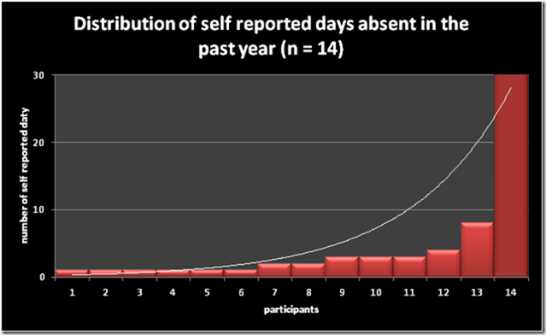
Survey results- Self-Reported Absences

Slide 45
Psychological Work Stressors
The two most common and frequent psychological stressors at work were identified as the absence of control over one’s workload closely followed by a feeling of being undervalued.
Other significant findings were lack of recognition from management and bullying in the workplace.

Slide 46
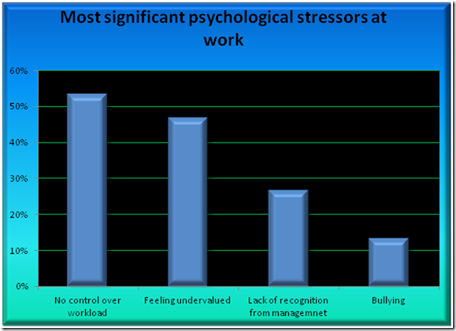
Survey results- Psychological Work Stressors

Slide 47
Survey results- Job Satisfaction
Factors that contribute to a positive work environment and job satisfaction are:
  Appreciation and recognition
  Effective communication
  Opportunities for continuing education
  Positive teamwork with collective strength and open communication

Slide 48
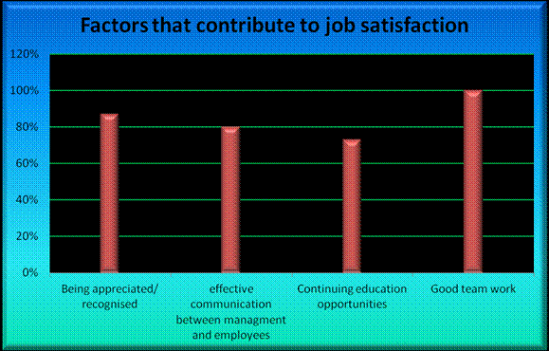
Survey results- Stimulating Job Satisfaction

Slide 49
Survey results- Job Dissatisfaction
Factors contributing to job dissatisfaction were identified as:
  Poor communication
  High acuity levels/increased workloads
  Lack of managerial support
  Bulling
  Unsafe working environments
  Nursing staff shortages
  Lack of supplies and equipment

Slide 50
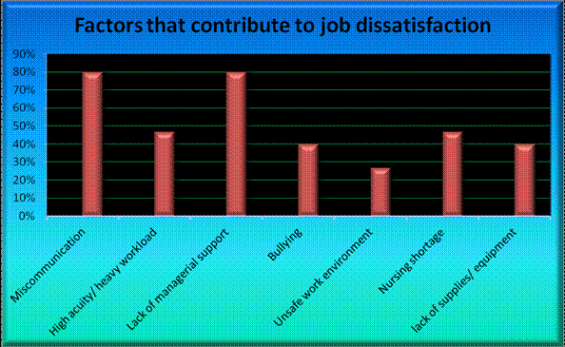
Job Dissatisfaction

Slide 51
Survey results- Suggested Interventions
Flexible work schedules (most desirable)
Wellness program
Reward systems
Disciplinary measures
Disability management program (least desirable)

Slide 52
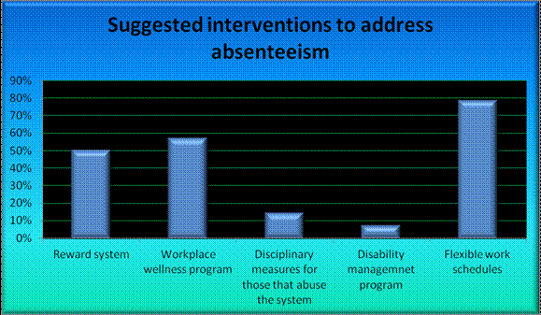
Survey results- Possible Interventions

Slide 53
Enhancing Job Satisfaction
Three most popular choices to enhance job satisfaction were
Involvment in organizational decision-making
Improved communication
Improved nurse-patient staffing ratios
Other suggestions
Self-scheduling
Facilitating breaks

Slide 54
Enhancing Job Satisfaction

Slide 55
Results
Survey results are inconclusive regarding the factors that influence absenteeism and the relationship to job satisfaction.
Results may be due to weak evidence and lack of rigor in the research methodology.
The study suggests that further research is required to determine if the null hypothesis can be rejected and in fact the two variables (absenteeism and job satisfaction) are correlated.

Slide 56
Conclusion
This study used a mixed-methods design, with qualitative focus groups and quantitatively an on-line survey method. The problem remains unaddressed. Further research is required due to the complexity of the variables, absenteeism and job satisfaction.

Slide 57
References
Absenteeism (n.d.). Retrieved March 18, 2016 from http://www.businessdictionary.com/definition/absenteeism.html
Absenteeism (n.d.) Merriam-Webster Dictionary. Retrieved March 18, 2016 from http://www.merriam-webster.com/dictionary/absenteeism
Canadian Federation of Nurses Unions. (2013). Absenteeism and overtime rates clearly indicate need for more emphasis on safe nursing staff numbers in Canada [Press release]. Retrieved from https://nursesunions.ca/news/absenteeism-and-overtime-rates-clearly-indicate-need-more-emphasis-safe-nursing-staff-numbers-i
Daouk-Öyry, L., Anouze, A.-L., Otaki, F., Dumit, N. Y., & Osman, I. (2014). The JOINT model of nurse absenteeism and turnover: A systematic review. International Journal of Nursing Studies, 51(1), 93-110. doi:10.1016/j.ijnurstu.2013.06.018
Davey, M. M., Cummings, G., Newburn-Cook, C. V., & Lo, E. A. (2009). Predictors of nurse absenteeism in hospitals: A systematic review. Journal of Nursing Management, 17(3), 312-330. doi:10.1111/j.1365-2834.2008.00958.x

Slide 58
References
Farquharson, B., Allan, J., Johnston, D., Johnston, M., Choudhary, C., & Jones, M. (2012). Stress amongst nurses working in a healthcare telephone-advice service: Relationship with job satisfaction, intention to leave, sickness absence, and performance. Journal of Advanced Nursing, 68(7), 1624-1635. doi:10.1111/j.1365-2648.2012.06006.x
Gaudine, A., & Gregory, C. (2010). The accuracy of nurses' estimates of their absenteeism. Journal Of Nursing Management, 18(5), 599-605. doi:10.1111/j.1365-2834.2010.01107.x
Gaudine, A., Saks, A. M., Dawe, D., & Beaton, M. (2013). Effects of absenteeism feedback and goal-setting interventions on nurses' fairness perceptions, discomfort feelings and absenteeism. Journal Of Nursing Management, 21(3), 591-602 12p. doi:10.1111/j.1365-2834.2011.01337.x

Slide 59
References
Group D focus group results (2016)
Joyce, K., Pabayo, R., Critchley, J. A., Bambra, C. (2010). Flexible working conditions and their effects on employee health and wellbeing. Cochrane Database of Systematic Reviews 2010, Issue 2. doi: 10.1002/14651858.CD008009.pub2
Ma, C., Samuels, M., & Alexander, J. (2003). Factors that influence nurses' job satisfaction. Journal Of Nursing Administration, 33(5), 293-299.
Magee, C. A., Caputi, P., & Lee, J. K. (2016). Distinct longitudinal patterns of absenteeism and their antecedents in full-time Australian employees. Journal Of Occupational Health Psychology, 21(1), 24-36. doi:10.1037/a0039138

