Slide 1
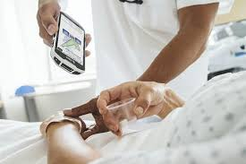
Bar Code Medication Administration: Patient Safety Initiative
(Zebra,n.d.)
Team 7 : Marlene Morrison, Shanthi Palaniappan & Carmen Stronski
Athabasca University
MHST/NURS 602 Transforming Healthcare Through Informatics
July 24, 2018

Slide 2
The Proposal
Objective: To create a proposal to implement a bar code medication administration (BCMA) system and electronic medication (eMar) administration record
Site: 36 Bed Surgical Inpatient Unit at a Community Hospital
Purpose: To improve patient safety and increase medication administration reliability with a goal of reducing future healthcare costs

Slide 3
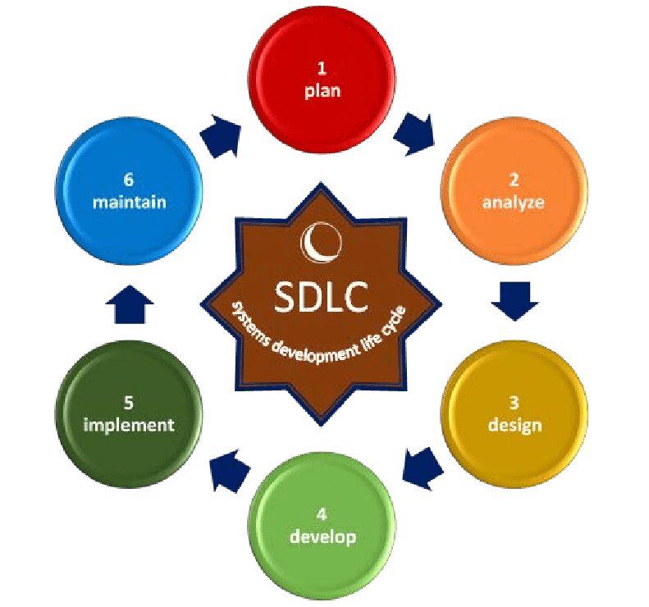
(Cervone, 2007)
Notes:
The system development life cycle is used to guide the process for this proposal. Project teams can be more effective if they understand the expectations and outcomes of each phase of the system development.

Slide 4
Introduction
Medication administration errors can lead to adverse drug events and represent a significant threat to:
Patient safety - causing harm or death
Result in significant costs to the healthcare system
Reduce patient and family confidence in healthcare
(Institute for Safe Patient Medication Practices [ISMP], Canada, 2013)

Slide 5
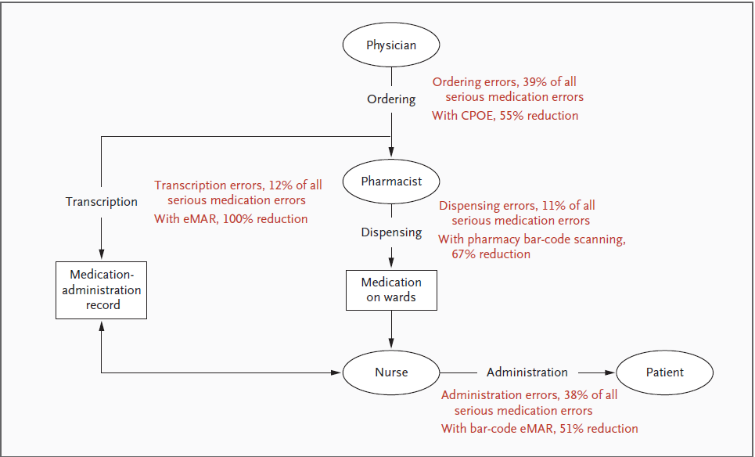
Significance of Informatics Problem
(Poon et al., 2010)
Notes:
Health care information technology has been publicized as a promising strategy for preventing medication errors . Bates (1995) identified that the administration phase of the medication-use process is the most error prone phase accounting for 34% of all errors originating in this phase. However, only less than 2% of medication administration errors are intercepted at the patient bedside, before reaching the patient . For this reason, BCMA along with CPOE have been deployed at hospitals to intervene and prevent potential medication errors from occurring during the medication administration phase . The above diagram represents percentage of medication errors at different phase of medication administration prior to and after implementing BCMA technology. Ordering errors of all serious medication errors -39% with CPOE, there was 55 % reduction rate in ordering errors.
Transcription errors 12% with eMAR 100% reduction rate. Dispensing errors 11%. With pharmacy bar-code scanning 67% reduction rate. Administration errors 38% with BCMA e-MAR 51% reduction rate thus supporting the positive effects of above HIT technologies in reducing overall medication errors.

Slide 6
Environmental Risk Analysis
Risk assessment in HIT includes identification of risk, risk analysis and proposal of suitable measures to reduce risks,as well as measures for risk maintenance on an acceptable level Nikolic & Ruzic Dimitrijevic, 2009)
Dual versus single medication record systems issue (Wideman et al., 2005)
Technology placement and usability issues -lack of available computer on wheels and scanners (Agency for Healthcare Research and Quality, AHRQ, 2008)
Issue with compatibility and functionality of scanners with hospital bar codes
Issue with durability of the wrist bands and bar codes(ISMP Canada, 2013)
Health IT/System downtime issues (ISMP Canada,2013)
Notes:
Dual versus single medication record system issue: The surgical unit in the local community hospital is currently using paper MAR (cMAR) to record medication administration. Dual medication system, ie., use of paper MAR in conjunction with electronic BCMA documentation increase the probability of medication errors and reduce nursing productivity. Moreover, paper MAR may present threats to patient safety and confidentiality of patient health information because it can only be used by one person at a time, can be easily damaged and lost. This risk can be eliminated by discontinuing the use of paper MAR when the BCMA- eMAR technology is implemented in the surgical unit. Also, the hospital is planning to implement CPOE in conjunction with the BCMA technology. With CPOE being implemented in conjunction with BCMA technology, such transcription errors could be reduced.
Technology Placement and usability issues: The med COWs are not integrated to the bar coding technology that allows for scanning yet. Also the nurses would not be able to take the med COW into patient rooms when administering medications, leading to potential errors in documentation of medication administration, outside of patient rooms. lack of available computer on wheels and scanners. Proposal for purchasing the scanners will be sent by hospital
The counter measure proposed for this risk is that the local community hospital prior to purchasing the scanners, should test scanners for compatibility and functionality with the actual bar codes that will be used in the community hospital (AHRQ, 2008). It is also important to consider the durability of patient wristbands and barcodes, because broken or unreadable codes and wristbands negate the benefits of the BCMA systems. The counter measure proposed is for the local community hospital to test the wristbands and barcodes prior to purchase and purchase only those that are durable enough to withstand the rigors of routine hospital use .
Policies for downtime issues has to be set up prior to BCMA implementation such as availability of paper forms for MD orders, paper MAR.

Slide 7
System Analysis
Using the (SDLC) approach the problem, feasibility will be examined
Problem: 15 medication administration error occurrences are noted each month and over 100 error events annually on this surgical unit.
Feasibility: This facility/unit has partially initiated the implementation of electronic medication administration, however, funding and budget approval is needed to add the balance of system required.
Notes:
The hospital presently as a cMar system in placed however, medication errors are still occuring. The organization will have to make a request for proposal (such as this ) and approach Share Services West (group of hospitals) once the proposal is approved funded will be provided from the senior management who maintain budget control

Slide 8
Collaborative Integrated Model
IT- To stall all the technology applications and ensure they are compatible to the present systems.
Pharmacy- Robot bar code medication once it is entered into the (CPOE) and generates an (eMAR) . Package and dispense to the unit.
Nurses- Scan name badge, scan patient wristband, administer patient medication.
Data immediately input in the computer,will generate real-time warnings or approvals. Automatically documented. (Ross, 2008)

Slide 9
Hardware
Bar coding machine will apply a bar code, package and dispense all medication (Euromed,n.d.)
Nurses use a Zebra scanner to scan patients wristband and medication to confirm a match (Zebra,n.d.)
This process ensures patients receive medication as per the 5 rights of medication administration
(Shah et al., 2016; Ross, 2008)
Notes:
Thanks Carmen

Slide 10
The Integration Engine ( BIZTalk)
Bi-directional BIZTalk is the required interface to connect and allow communication between Swisslog and Meditech
(Personal Communication,Peter Murphy, July,24th,2018)

Slide 11
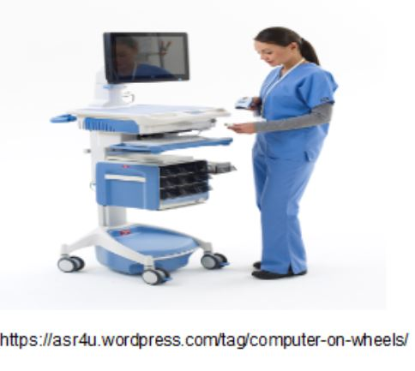
Software
A laptop equipped with Microsoft Windows, access to a wireless network and each equipped with a mouse.
Meditech system with capability to support the BCMA system (About MEDITECH, n.d.)
A medication cart will be needed to store the patients’ medications (ASR Healthcare, 2018)

Slide 13
Economic Analysis
Estimated cost of a BCMA enabled bed is $56,000.00 - $84,000.00 over a 5 year period
Project investment is estimated at $1,800,000.00
Existing infrastructure may influence project implementation costs
Sakowski & Ketchel, 2013)
Notes:
The cost to implement a BCMA system is estimated at $56,000 - $84,000 per BCMA enabled bed over a five year period. Although there is significant infrastructure investment, actual return on investment may appear as hard and soft cost benefits.

Slide 14
Cost of Medication Administration Error
A medication administration error can extend a patient’s length of stay in hospital by 4.6 days
4.6 days x $5992.00 (cost/day) = $27,562.20
The cost per medication administration error event costs the Canadian Healthcare system an estimated $6,655.00
(Canadian Institute for Health Information, 2017; Shah et al., 2016).
;
Notes:
It costs an average of $5992.00 for a daily stay in hospital in Canada. It is estimated that a medication administration error could extend the length of stay of a patient in hospital by 4.6 days costing $27,562.20 per event.

Slide 15
Hard Versus Soft Cost Benefits Explained
Hard Cost Benefits
Reduced patient days in hospital and associated care costs
Reduced inventory carrying costs appropriate for care
Reduced liability premiums due to a reduction in patient harm
events
Soft/Indirect Cost Benefits
Reduced follow-up monitoring costs
Reduced harm-associated drug and support costs
Increased efficiency in admitting and discharging patients
Improved electronic health record accuracy and availability
Improved provider compliance and reporting system errors (ISMP Canada, 2013)
Notes:
. This event could potentially cost the healthcare system an additional $27,563.00. Patient safety becomes a primary team focus
It is unlikely that the resultant efficiencies would manifest themselves as simple budgetary savings.

Slide 16
Education Plan
Education plan with system training builds on the foundation of
safety, but is specific to the final operational functionality of the
planned system (ISMP Canada, 2013).
Three levels of training:
Level 1 Basic classroom work
Clinical simulation environment training
Live Integration and mentoring by “super users” (ISMP Canada, 2013)
BCMA Cross-training between nursing and pharmacy (ISMP Canada, 2013; Wideman et al; 2005)
Notes:
Education Planning for the BCMA system training builds on the foundation of safety, but is specific to the final operational functionality of the planned system. Collaborative team effort amongst nursing,pharmacy, physicians and other healthcare team providers is reinforced during training. The Institute for safe patient medication practices Canada recommend three levels of training prior to and during go live stages of BCMA implementation.
Basic Classroom training for 4 hours where training leads trainees through multiple screens providing system functionality overview;communication methods with pharmacy staff, interruption of service procedures, major down-time issues, or other known potential site issues, change in hospital policy for med administration and patient identification such as charting in patient rooms, procedure for 5 rights, downtime procedures,explaining policies for allowing exceptions for bar-coding during medical or surgical emergencies.
Clinical Simulation Environment Training:trainees are exposed to simulated clinical situations which reflect the clinical circumstances found in the surgical unit. Examples may include medication “range” orders, “as required or prn” orders, “stat” orders, emergent care situations, This training provided the staff with an opportunity to test the system in a safe environment, where they would not cause an accidental adverse drug event.
Live Integration and mentoring by super users: A "Super User" is defined as a nurse, pharmacist, or other clinical staff member who has received extra training on the new BCMA system and has demonstrated the ability to provide peer-to-peer support during implementation. Presence of "superusers" and other support staff in the hospital unit is critical to successful roll-out and implementation of BCMA initially for 24 /7 for few days to a week and then taper to oncall support. Vendor support also initially 24/7 for 2-3 days, then taper to oncall support.
Cross Training: To enhance the probability of long-term success of the project, multidisciplinary cross-training is essential, to increase the staff members understanding and competency in BCMA technology.During this training, pharmacists are cross-trained on nursing aspects of BCMA and nurses cross-trained on the pharmacy specific features. The user issues faced by both parties become highly visible as nurses observe pharmacy staff finishing medication orders and troubleshoot BCMA problem in the inpatient pharmacy and the pharmacists accompany nurses on the BCMA administration rounds,

Slide 17
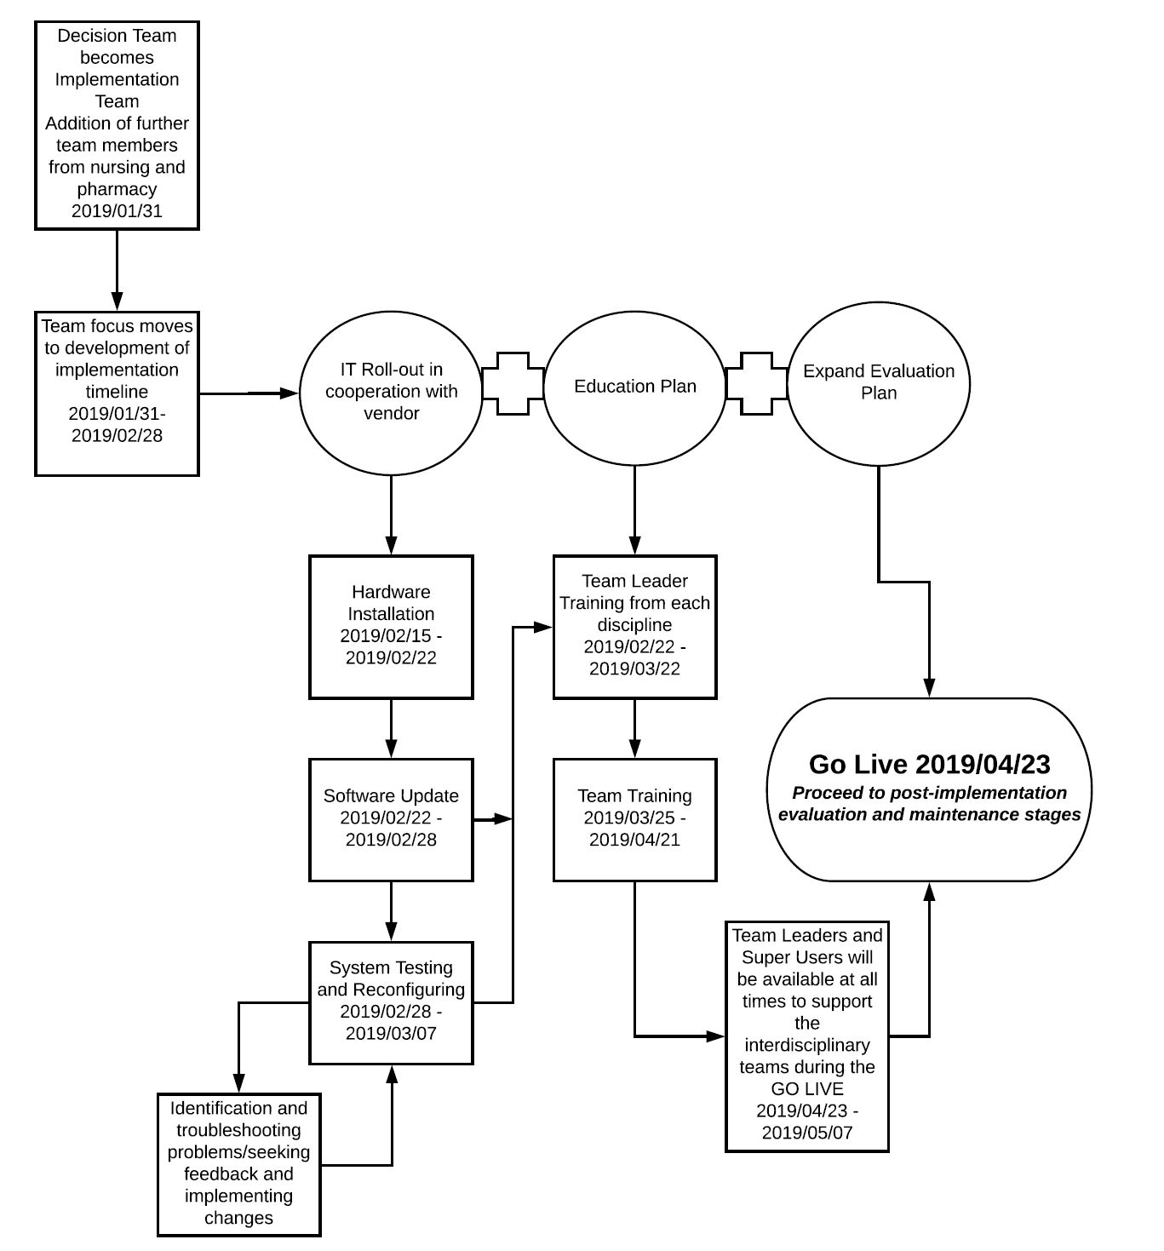
BCMA and e-MAR Implementation Timeline
(Suc et al., 2009; ISMP Canada, 2013; Chen, Osman, Nunes & Peng, 2011).
Notes:
Decision making, planning and implementation can be expected to take 8 - 12 months. Attention to planning and preparation details can help to ensure system implementation success. Leadership teams should include staff in the process and gauge readiness for change. Staff education and ongoing support are key factors to creating a supportive organizational culture

Slide 18
Potential Issues
BCMA technology within EHR can have a positive effect on
patient safety.
As with any new system, there are opportunities to overcome challenges and barriers to successful implementation (Ben-Assuli, 2015).
Privacy -computer on wheels not suitable for interruptive environments (Ash et al.,2004)
Security -sharing of passwords, virus and spyware attacks to the system (Narayana samy et al.,2010)
Ethical -unauthorized users of EHR outside of circle of care (Cushman et al., 2010)
Social - non-compliance of staff members with new technology (Kaplan & Harris-Salamone, 2009)
Ergonomics- lack of available computer on wheels affect nurses workflow (AHRQ,2008)
Economics - significant investment for start-up cost (Poon et al., 2010)
Notes:
Privacy:computer on wheels (COWs) are not suitable for highly interruptive environments such as hospital environments (Ash, Berg, Coiera, 2004). There is a high chance for nurses to leave their computer screen signed on when working in multiple tasks in a hospital setting, allowing accessibility of personal patient information to other health care providers outside of the circle of care as well as to the public.
Security:threats to security includes sharing of passwords among employees, virus and spyware attacks to the system. Security issues may arise when data from BCMA software is transmitted across the facility’s informatics system through wireless Internet. To minimize these issues, the software within the BCMA application will comply with national standards for the security of electronic protected health information (e-PHI) and electronic exchange as established by HIPAA.
Ethical: Inappropriate access to health records is a threat to an individual’s privacy that can result in embarrassment and other harm. To preserve confidentiality and privacy with patient health information in electronic heath records, it is important to ensure, employees who have authorized access, called as “authorized users”, would only be allowed to access those files and information.
Social: Social issues, including non-compliance of staff members with the new BCMA system, may pose barriers to successful implementation Establishing a collaborative MTD during the design and evaluation processes of the BCMA system will ensure that all users of the application will be represented and that the implementation of BCMA will enhance users’ workflow.
Ergonomics: Human factors principles and user centered design should be considered when designing, developing and implementing BCMA systems. Prompt attention and troubleshooting issues can help prevent the development of work-arounds by your team. Ergonomic issues, such as interruptions of nurse’s workflow because of lack of available workstation on wheels (WOW), may also contribute to non-compliance with the application. WOWs will be readily available and set up to be user-friendly (e.g. placed in convenient locations) so as to minimize any disruption of a nurse’s workflow.
Economics: Significant inverstment for start-up cost, few million dollars are needed and hence proposal will be submitted by local hospital for provincial funding.

Slide 19
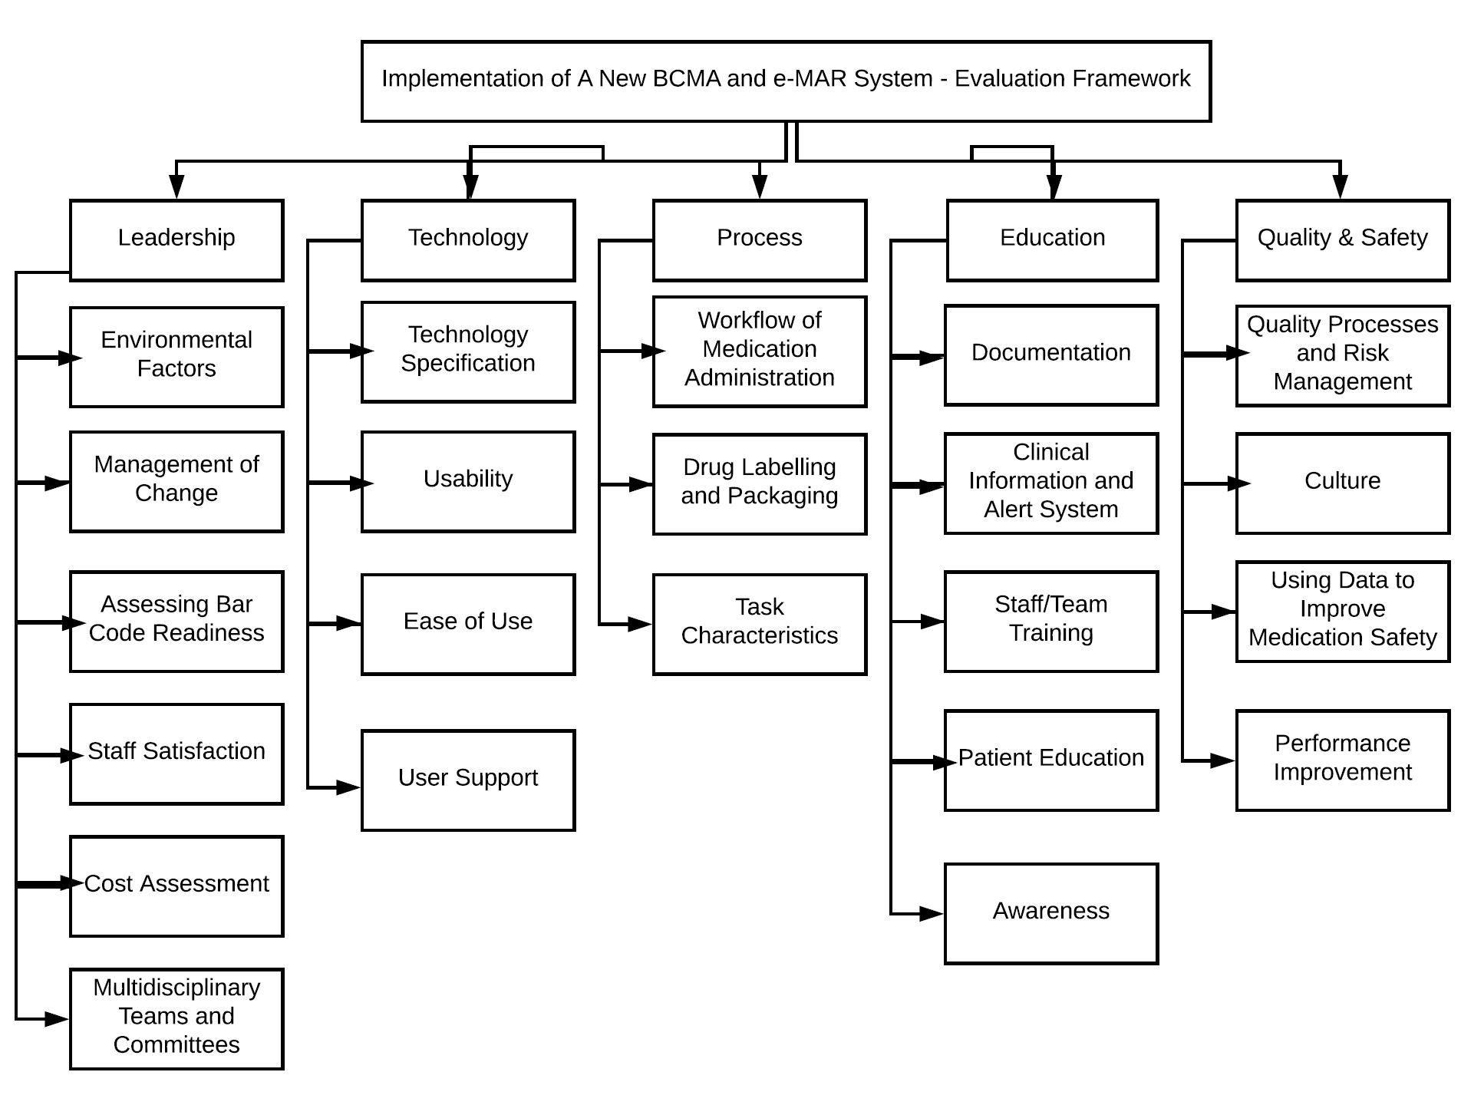
System Evaluation Framework
(Al Mustafa, Khan & Hussain, 2018)
Notes:
A change in any medication administration system is a multi-disciplinary process that requires all members of the healthcare team to make adjustments and thoughtfully plan for successful implementation. The evaluation process begins with leadership, technology, process and workflow. Followed by education and commitment to quality and safety

Slide 20
Steps to Ensure Success
How can your leadership team ensure success?
Create a change management plan
Create and develop your leadership teams - management, pharmacy, nursing, physicians & IT to help lead change. Include your staff in the process. This is a team effort!
Initiate evaluation and re-evaluation processes following system implementation (this is long term maintenance)
Schedule team meetings weekly to evaluate and problem-solve issues
Actively seek feedback from your team members and staff via open communication and post-implementation surveys on a regular basis
(ISMP, Canada, 2013)
Notes:
Successful change begins with a plan. Change management theories can help guide the process. The overriding lesson is that post-implementation satisfaction and system issue identification should be applied over a long period of time. Provider surveys should not be a single event, and certainly not only immediately after implementation. A longer term assessment, and reassessment, allows the planning team to deal with a variety of issues in a prioritized manner, always communicating to the affected providers. These surveys, and related communications, signal important collaborative commitments to providers: Communication channels are open for business. Inter-disciplinary system cohesiveness and collaborations are working. Users are valued. Major safety or operational concerns will be identified before they become “latent errors”. Subjective minor irritations, which have the potential to cloud overall user satisfaction or compliance, will be discussed.

Slide 21
Thank You
Team 7
Marlene, Shanthi and Carmen
NURS602, Athabasca University
July 24, 2018

Slide 22
References
About MEDITECH, (n.d). Introducing Meditech expanse. Retrieved from https://ehr.meditech.com/about-meditech/about-meditech
Al Mustafa, S. A., Khan, M., & Hussain, M. (2018). Implementing Barcode Medication Administration Systems in Public Sector Medical Units. International Journal of Decision Support System Technology, 10(2), 23-39. doi:10.4018/IJDSST.2018040102
Agency for Healthcare and Research Quality (AHRQ). (2008). Health Information Technology Archive: Bar-coded Medication Administration. Retrieved from https://healthit.ahrq.gov/ahrq-funded-projects/emerging-lessons/bar-coded-medication-administration
Ash, J., Berg, M., & Coiera, E. (2004). Some unintended consequences of information technology in health care: the nature of patient care information system-related errors. Journal Of The American Medical Informatics Association, 11(2), 104-112. Retrieved from http://www.ncbi.nlm.nih.gov/pmc/articles/PMC353015/
ASR Healthcare. (2018). Stretch point of-care-budgets with refurbished mobile carts. Retrieved from https://asr4u.wordpress.com/tag/compuer-on-wheels/
Ben-Assuli, O. (2015). Electronic health records, adoption, quality of care, legal and privacy issues and their implementation in emergency departments. Health Policy, 119(3), 287-297. doi.org/10.1016/j.healthpol.2014.11.014

Slide 23
References
Cervone, H. F. (2007). The system development life cycle and digital library development. OCLC Systems & Services: Internal digital library perspective, 23(4)-348-352. https://doi.org/10.1108/10650750710831484
Chen, S., Osman, M., Nunes, J. M., & Peng, G. C. (2011). Information systems evaluation methodologies. In; Proceedings of the IADIS International Workshop on Information Systems Research Trends, Approaches & Methodologies (ISRTAM). Retrieved from http://eprints.whiterose.ac.uk/74740/1/WRRO_74740.pdf
Cushman, R., Froomkin, A., Cava, A., Abril, P. & Goodman, K. (2010). Ethical, legal and social issues for personal health records and applications. Journal of Biomedical Informatics, 43, S51-S55. https://doi.org/10.1016/j.jbi.2010.05.003
EuroMed Technologies Company Limited. (n.d.). Automated Drug Management Systems (ADMS). Retrieved from http://www.euromedhk.com/adms.php
Institute for Safe Medication Practices Canada. (2013). Medication bar code system implementation planning: A resource guide. Canadian Pharmaceutical Bar Coding Project. Retrieved from https://www.ismp-canada.org/barcoding/download/ResourceGuide/BarCodingResourceGuideFINAL.pdf

Slide 24
References
Kaplan, B., & Harris-Salamone, K. D. (2009). Health IT success and failure: Recommendations from literature and an AMIA workshop. Journal of the American Medical Informatics Association, 16(3), 291-299. doi: 10.1197/jamia.M2997
Narayana Samy, G., Ahmad, R., and Ismail, Z. (2010). Security threats categories in healthcare information systems. Health Informatics Journal, 16(3), 201-209. doi:10.1177/1460458210377468
Nikolić, B., & Ružić-Dimitrijević, L. (2009). Risk Assessment of Information Technology Systems. Issues in Informing Science & Information Technology, 6, 595-615.
Poon, E. G., Keohane, C. A., Yoon, C. S., Ditmore, M., Bane, A., Levtzion-Korach. O., &... Gandhi, T. K. (2010). Effect of bar-code technology on the safety of medication administration. The New England Journal of Medicine, 362, 1698-1707. https://doi.org/10.1056/NEJMsa0907115
Ross, J. (2008). Collaboration-Integration nursing, pharmacy and information and barcode medication administration system implementation. CaringNewsletter, 23(1) 1-17.
Sakowski, J. A., & Ketchel, A. (2013). The cost of implementing inpatient bar code medication administration. American Journal of Managed Care, 19(2), e38-e45. Retrieved from https://www.ajmc.com/journals/issue/2013/2013-1-vol19-n2/the-cost-of-implementing-inpatient-bar-code-medication-administration?p=3

Slide 25
References
Suc, J., Prokosch, H. U., & Ganslandt, T. (2009). Applicability of Lewin’s change management model in a hospital setting. Methods of Information in Medicine, 48(5), 419-428. doi:10.3414/ME9235
Wideman, M. V., Whittler, M. E., & Anderson, T. M. (2005). Barcode medication administration: Lessons learned from an intensive care unit implementation.Agency for Healthcare Research and Quality Rockville MD
Zebra. (n.d.) Improve patient safety with accurate medication administration. Retrieved from http://Zebrawww.zebra.com/us/en /solutions/healthcare/identity/barcode-medication-administration.html

