Slide 1

Proposing an Informatics Solution to a Problem
Implementing EPIC EHR at the Queen Elizabeth II Hospital in Halifax, Nova Scotia
By: Courtney Noseworthy, Gabrielle Proper and David Razao

Slide 2

What is the Problem?
The need for an electronic health record (EHR) to address the limitations of the current paper based medical record at The QEII Hospital in Halifax, Nova Scotia.
Paper-based patient records present with a poor and unstructured format leading to ineffective and time-consuming use.
The availability of the patient record is location bound and with time paper records become bulky leading to a lack of overview.
Other limitations include: illegible handwriting, ambiguous and incomplete data, data fragmentation, and poor data availability.
These limitations can be considered to be an impediment to the continuity of care.

Slide 3
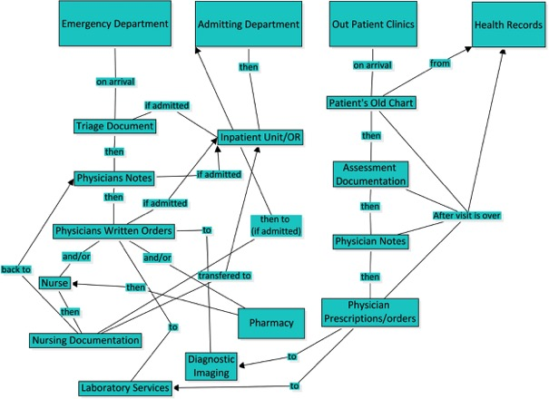
Flow of Paper Based Documentation

Slide 4
Why is this problem significant?
Patients and families will have electronic access to their personal health plan, test results, and visit history and will spend less time repeating their history to different caregivers.
Information systems that facilitate data collection and tracking for patient care can sustain care and quality improvement.
EHR systems can be augmented with computerized physician order entry (CPOE), electronic prescribing and decision support features.
Computer-based decision support systems have been shown to improve patient safety by reducing the rate of prescribing and documentation errors and subsequent adverse events.
Staff are provided with alerts for suggested corollary actions, potential drug interactions and adjustment of drug doses, a task poorly performed by human prescribers without aid.

Slide 5

What are we proposing?
The implementation of the EPIC Electronic Health Records System in keeping with the Nova Scotia District Health Authority integrated health records network.
By introducing EPIC in the Queen Elizabeth II hospital, we hope to remedy the problems that exist with paper documentation and seek to increase patient safety and care efficiency

Slide 6

Environmental Risk Analysis
The EPIC electronic health record can alleviate labor intensive filing and retrieval inefficiencies associated with paper documentation.
EHR’s can decrease error reduction and increase patient safety.
EHR’s can provide portability of information while protecting patient confidentiality.
Clinical knowledge can be enhanced and better decision making skills can be performed.

Slide 7
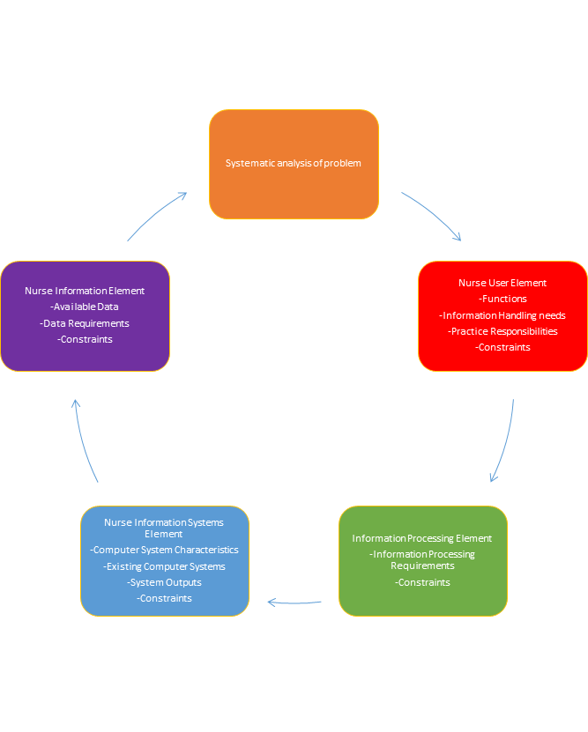
Systematic Analysis of the Problem
This chart provides a systematic analysis using the requirements of the nursing information system. This model involves four steps:
  nurse user element
  information processing element
  nursing information systems
  the nurse information element.
Provides a holistic approach to address the need for electronic health records versus the current paper documentation system at the QEII Hospital in Halifax, Nova Scotia. The arrows represent the flow of inputs and outputs within the system.
(Gassert, 1996)

Slide 8
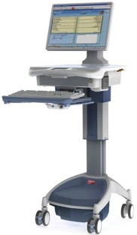
Hardware Selection and Rationale
Implementation of the the EPIC system will require all inpatient units to have IBM computers.
Each computer will have a HP Elitebook Folio 9470M with 2 gigahertz.
Each unit will have a keyboard and wireless mouse and the processor will include
quad core with 8 gigs of ram.
Every unit within the QEII Hospital will have 6 computers on wheels to provide all health care professionals with a mobile workflow.
EPIC was used for its evolving applications and easy usability.
The hardware was chosen because it was the most cost effective while providing
easy accessibility to patient information.

Slide 9

Software Selection
Windows 7 with 32 bit was used as the software to support the EPIC system.
The default browser used is Internet Explorer.
EPIC software can store data from an standard based electronic system or compatible data source.
EPIC system can provide the system with tools to resolve patient care gaps through a web-based care management portal.

Slide 10
Implementation Plan
Assembly of an Electronic Health Records Core Team (CMA, 2012)
  Construction of system for each care area
  Strategic Implementation and Education planning
Phased implementation over 18 months (Figlietti, 2016)
  Phase 1: Outpatient Clinics
  Phase 2: Inpatient Units, Emergency Department, Intensive Care/ Neonatal Intensive Care/
  Cardiac Care Units and Pharmacy
  Phase 3: Operating Room/Post Anesthesia Recovery Unit
Go-Live of phases 1 and 2 prior to Viral season 2019; fully implemented by April 1st, 2020
July 31-Sept.21,2018
Sept. 24, 2018-
Apr.29, 2019
July 8=Aug 16, 2019
Go-Live Aug. 26.2019
Aug. 19-Oct. 24, 2019
Go-Live Oct, 14, 2019
Jan. 8-Feb. 28, 2020
Go-Live Mar. 16,2020
Preparatory Activities
Software Construction/Testing
Phase 1 Education and Go-Live
Phase 2 Education and Go-Live
Phase 3 Education and Go-Live
Assemble core EHR team, establish Go-Live dates, make implementation plan, etc.
Unit specific dates for construction, meeting unit specific needs for EHR use
Phased Education for Outpatient Clinics (Super-Users, physicians, clerks, other allied health)
Phased Education for all Inpatient Units/Pharmacy (Super-Users, physicians, clerks, other allied health
Phased Education for OR/PACU (Super-Users, physicians, clerks, other allied health

Slide 11

Education Plan
Phased Education for Staff (Figlietti, 2016)
The Core EHR team will identify 6 Super Users on each
units as well as the Units Educator to act as support
during the Go-Live.
Super Users will receive additional training to be able
to help troubleshoot any small problems.
Education will group common roles (physicians, clerks,
RNs, etc.)
  Phase 1: Outpatient Clinics
  Phase 2: Inpatient Units, Emergency Department,
  Intensive Care/ Neonatal Intensive Care/ Cardiac
  Care Units and Pharmacy
  Phase 3: Operating Room/Post Anesthesia Recovery Unit
General staff training will occur as close to Go-Live date as
possible (approx. 2 weeks prior).

Slide 12
Dates | Activity/Attendance | Instructor
April 1 to 29, 2019 | Train the Trainer: -EHR point people (education leader and unit representatives) will aid in the creation and testing of the software. -The EHR point people will then become the trainers in conjunction with EPIC consultants. | EPIC Consultants
-July 8th-12th, 2019 (Outpatient Clinics) -August 19th-23rd, 2019 (Pharmacy, Inpatient Units, ED, ICU, NICU, CCU) -January 13th-17th, 2020 (Operating Room/ PACU) | Train the Super-User -Each Unit will Select 6 Super-Users (in addition to the unit Educator) to help support the team during the implementation phase. -These Super-users will receive additional training in order to help staff troubleshoot problems and support the learners during the implementation. -These Super-Users will still attend a regular training day with their colleagues. -By the end of the Super-User training session, they will be able to help solve minor problems (linking IV Lines, Printing blood sample labels, managing a medication discrepancy, etc.) | EHR Team (Education Subgroup)
-July 15th-August 16th, 2019 (Outpatient Clinics) -August 26th- October 4th, 2019 (Pharmacy,Inpatient Units, ED, ICU, NICU, CCU) -January 20th, February 28th, 2020 (Operating Room/ PACU) | Train the Users -A phased approach beginning with the admin staff then the nurses and allied health and physicians. -Users will be shown the software and allowed to practice using simulated patients in the training environment in a structured session of 4 hours with potential for an additional 4 hours based on unit needs (code blue charting, sedation charting, etc.) -Super Users will be Present at regular training to deepen their knowledge and assist instructor | EHR Team (Education Subgroup), Unit Educators

Slide 13
Evaluation Plan
Sample of 2 week post-implementation survey questions
Frequent short surveys will be given out throughout the implementation.
User satisfaction will be surveyed post-training, post implementation (2 weeks, 1 month and 6 months).
At a minimum of 6 months post-implementation, data collection on:
  medication administration errors
  patient satisfaction
  Critical incident occurrence
 | 1- Strongly Disagree | 2- Disagree | 3- Neither Agree nor Disagree | 4- Agree | 5- Strongly Agree
The Training was sufficient
The Super Users on my unit have been helpful
The program is user friendly
I can find what I need easily
The program has made a positive change in my practice

Slide 14

Potential Issues:
Privacy
The possibility exists of unauthorized access or misuse owing to improper security implementation.
To preserve privacy,one necessary part is to limit access to the records to allowed parties.
Diligent architectural design is an essential step to make such a complex system function correctly.
Password changes every 3 months
Security
Threats include sharing passwords, viruses and spyware attack
Data encryption
Spam filtering
Secure servers

Slide 15
Potential Issues (continued)
Legal
Follow federal laws regarding breach prevention
Obtaining appropriate consent to disclose information
Monitoring staff for improper access outside circle of care.
Social
Staff resistance to change
Appropriate education and follow up
Ease of use
User satisfaction

Slide 16
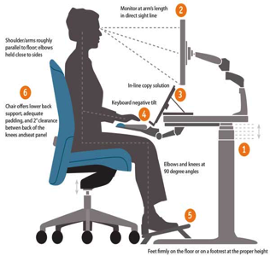
Potential Issues (continued)
Ergonomic
Potential physical issues: eye strain, Carpal tunnel Syndrome, muscle tension
Equipment positioning
Adjustable heights
Appropriate staff education
Economic
Cost analysis
Start up cost
Improved patient outcomes over time

Slide 17
In Summary
The implementation of EHR is known to increase patient safety and staff efficiency
The cost, even though high, is entirely justified by the inevitable benefits of its use
Constant evaluation of the process and open lines of communication with the users will allow solutions to be found to problems as they arise

Slide 18
References
Arduini, F., Cinti, S., Scognamiglio, V., Moscone, D., & Palleschi, G. (2016). How cutting-edge technologies impact the design of electrochemical (bio) sensors for environmental analysis. A review. Science Direct, 959(22), 15-42. doi.org/10.1016/j.aca.2016.12.035
Canadian Medical Association. (2012). Managing Medical Records. Retrieved from
https://www.cma.ca/Assets/assets-library/document/en/practice-management-and-wellness/module-7-emr-e.pdf
Epic Community. (n.d.). Retrieved from https://www.epic.com/community
Figlietti, C. D. (2016). Developing an Electronic Health Record Training Program for New Employees. University of San Francisco. Retrieved from https://repository.usfca.edu/cgi/viewcontent.cgi?article=1105&context=dnp
Gassert, C.A. (1996). Defining information requirements using holistic models: Introduction to a case study. Holistic Nursing Practice, 11(1), 64-74. Retrieved from http://cmapspublic2.ihmc.us/rid=1P7LSJPJ0-G3HPC6-1FS/Gassert%20-%201996%20-%20Defining%20information%20requirements%20using%20holistic%20m.pdf
Software. (n.d.). Retrieved from https://www.epic.com/software#PopulationHealth
Technology. (n.d.). Retrieved from https://www.epic.com/technology

