Slide 1
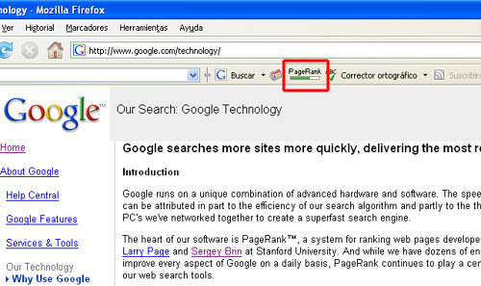
Nº | NOMBRE DEL SISTIO | PG | BACKLINKS
1 | ADOBE READER-DOWNLOAD | 10 | 1070000
2 | WORLD WIDE WEB CONSORTIUM | 10 | 464000
3 | GOOGLE | 10 | 307000
4 | GOOGLE DIRECTORY | 10 | 228000
5 | U.S. GOVERNMENT'S OFFICIAL WEB PORTAL | 10 | 141000
6 | MICROSOFT CORPORATION | 10 | 126000
7 | ADOBE SYSTEMS INCORPORATED | 10 | 115000
8 | SCIENCE MAGAZINE | 10 | 108000
9 | AMERICAN ASSOCIATION FOR THE ADVANCEMENT OF SCIENCE | 10 | 99600
10 | NASA | 10 | 92600

